Slide 1
Alojz Gomola
Obstacle avoidance based on Reach Sets
29th March 2019
Porto
Doctoral Thesis in Applied Mathematics Defense Presentation
Notes:
Good Afternoon,
My name is Alojz Gomola
I am working for Honeywell under Marie Curiie project MarineUAS
I am here to talk about Obstacle Avoidance Based On Reach Sets

Slide 2
Overview
Sense & Avoid introduction:
Context of SAA
Actors
Reactive Obstacle Avoidance
Problems in Detect & Avoid:
Explained as a story
Incremental problem definition
Related work:
Movement Automaton
Surveillance
Navigation
Reach set estimation
Proposed framework:
Overview
Avoidance Run
UTM Implementation
Rule Engine
Simulations:
Test Plan
Obstacle avoidance
Weather avoidance
Rules of the Air
Cooperative vs. Noncooperative
Conclusion

Slide 3
Sense & Avoid Introduction: Airspace classification UAS Traffic Management Terminology Reactive Avoidance
Notes:
That was story folks !
Now lets get to the serious talks!
I will introduce terms and process of Obstacle Avoidance

Slide 4
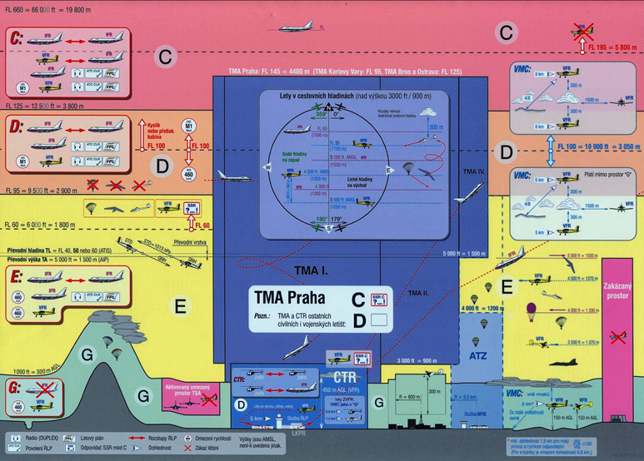
Context of SAA: Airspace classification (2.2)

Slide 5
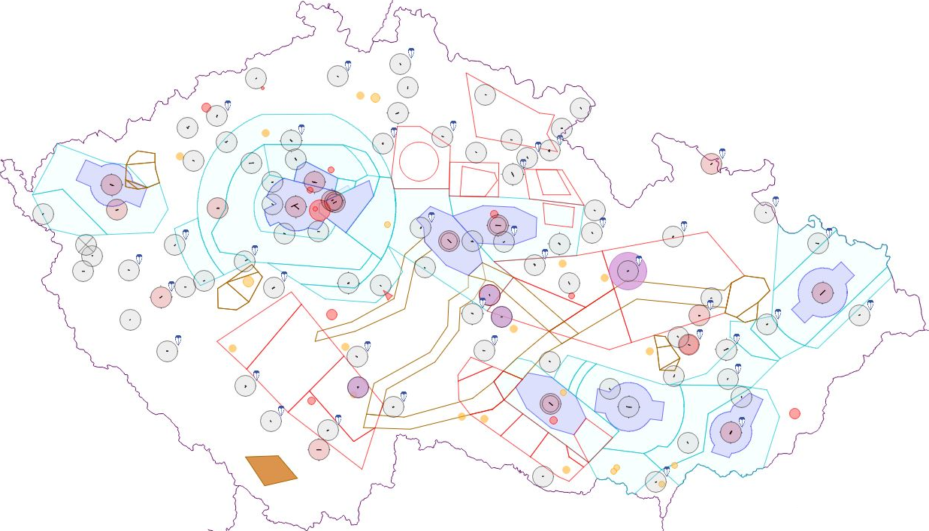
Context of SAA: Airspace restrictions (2.3)
Airport
Control zone
Temporary area
*Example of air traffic constraints is taken from Czech national air traffic control portal (http://aisview.rlp.cz/)

Slide 6
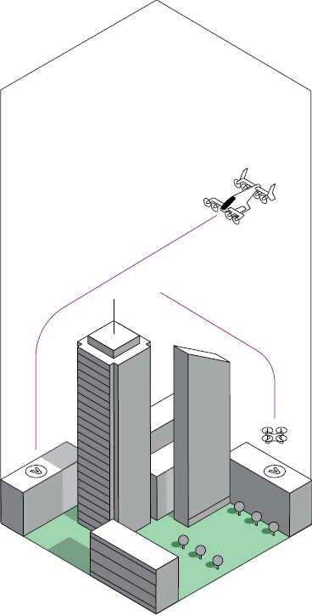
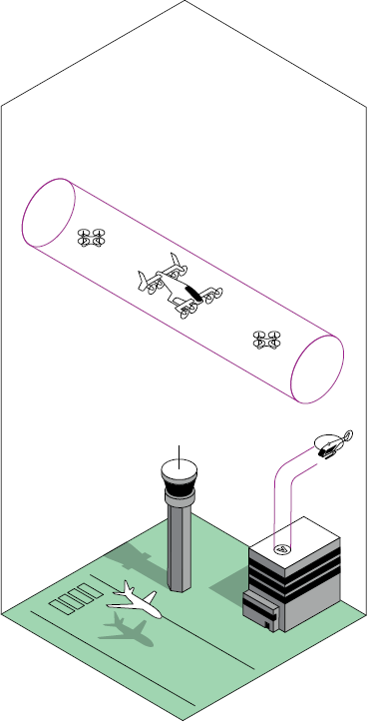
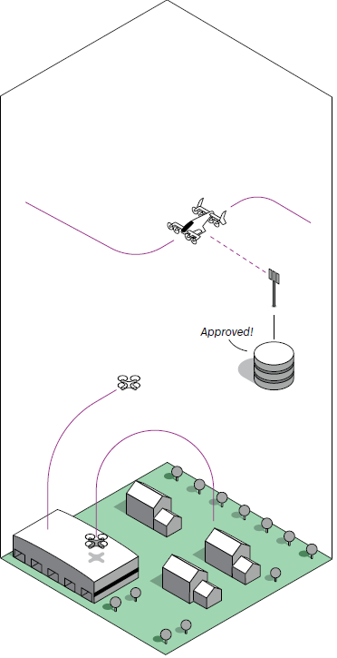
Context of SAA: UAS Traffic Management (UTM) (2.5)
a

Slide 7
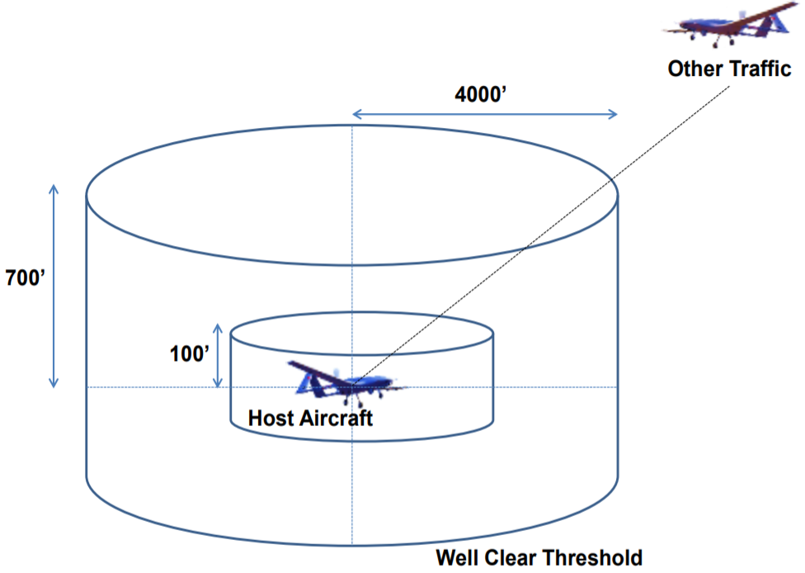
Context of SAA: Goal in controlled airspace: Remain well clear

Slide 8




Context of SAA: Actors introduction
UAS
Adversary
Intruder
Static obstacle
Notes:
Our main focus is to keep UAS safe while doing its business ,
There are Intruder planes which tell us where we are and tries to not harm UAS
Next are not so kind Adversaries which do not care about UAS nor Active avoidance
Then there is the greatest enemy of UAS, everlasting ground and its related obstacles.

Slide 9
Context of SAA: Reactive Sense & Avoid
Field of Vision
(FOV)
Obstacle
Waypoint
$$W_{1}$$
Avoidance execution
Reactive obstacle avoidance
Obstacle detection
Waypoint
$$W_{3}$$
Waypoint
$$W_{2}$$
Planned path
Notes:
UAS is flying some mission given by set of navigation waypoints
Obstacle enters into Field of Vision,
Our algorithm for “Reactive” obstacle is triggered.
UAS will avoid the danger and safely finishes the mission

Slide 10
Problems in Detect & Avoid: Explained as a story Incremental problem definition
Notes:
I will tell you nice introduction story for Obstacle avoidance

Slide 11
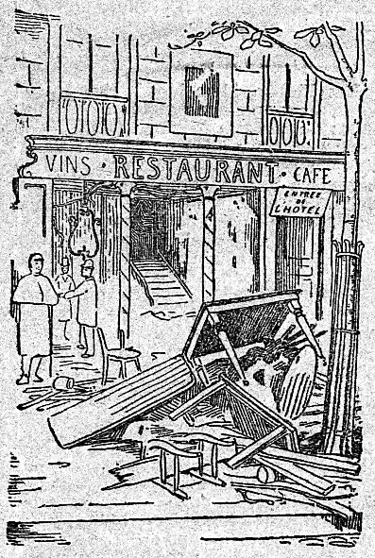

<-
<-
<-
How this gentleman
gets
into the Fine Restaurant
[1]https://commons.wikimedia.org/wiki/File:Le_restaurant_V%C3%A9ry_-_ext.png
[2]https://commons.wikimedia.org/wiki/File:A_gentleman,_walking_towards_the_left_and_drawing_his_sword_from_the_sheath,_wearing_a_plumed_hat_and_boots_with_spurs_MET_DP829192.jpg
Notes:
The gentleman want to get into the fine restaurant

Slide 12
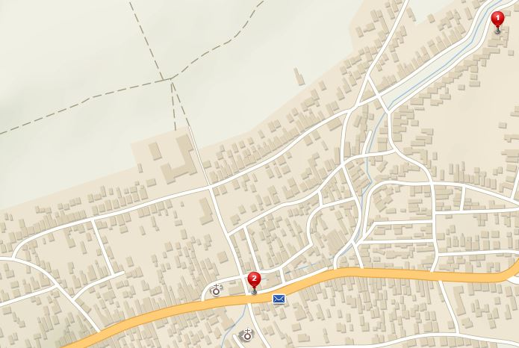
How to get to the fine restaurant ?
Östlichesburg
~ 1269 AD
Home
Restaurant
Notes:
There is a situation, Gentleman is at Home
Restaurant is near city center

Slide 13
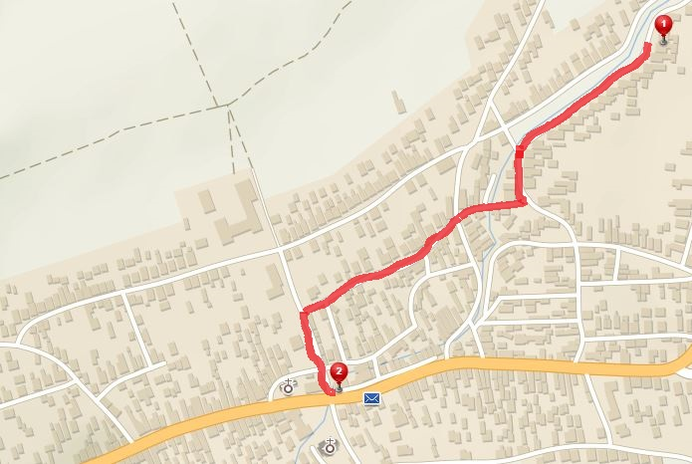
No problem, I know a map of my surroundings
[P1] Path planning problem:
1. Get MAP
2. PLAN then EXECUTE the PATH
Path to restaurant
Notes:
Path planning problem is introduced,
Plan and Execute a Path to Restaurant,
Really simple, nobody is on streets, I have precise and correct information and map,
Now lets make a life harder

Slide 14
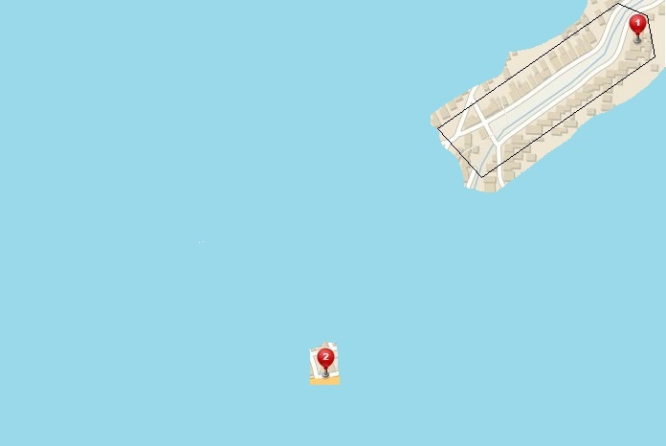
Forget your map, know the restaurant location
[P2] Evolving world:
1. Obtaining knowledge over time
2. Continous Decision Making
My Position
Field of Vision
GOAL
Notes:
There is a challenge (problem), Map forgotten,
Possibilities to see all of situation are limited.
We still know where is GOAL of our Journey.
There Is a Evolving World Challenge,
Need to make decisions with limited sensory reading is inevitable

Slide 15
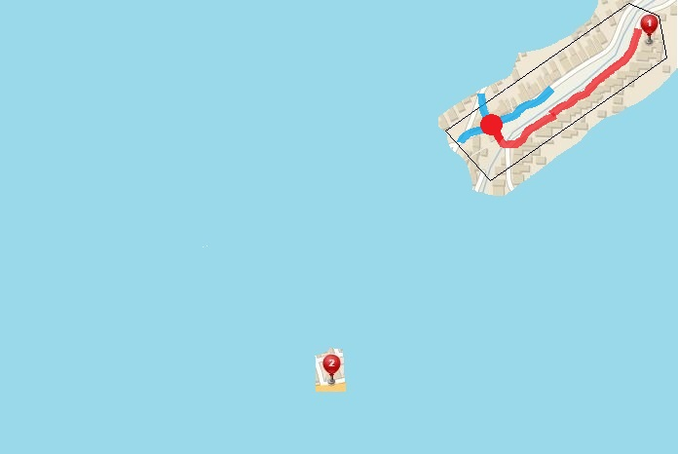
I get to the first intersection, now what ?
Decision Point:
Way 3
Way 2
Way 1
Decision point
Passed trajectory
GOAL
Apply COST Function
In
Decisions
Notes:
Get to the end of charted territory, at the DECISION POINT
Crossroad has three ways,
We chose one which gets us closest to our GOAL

Slide 16
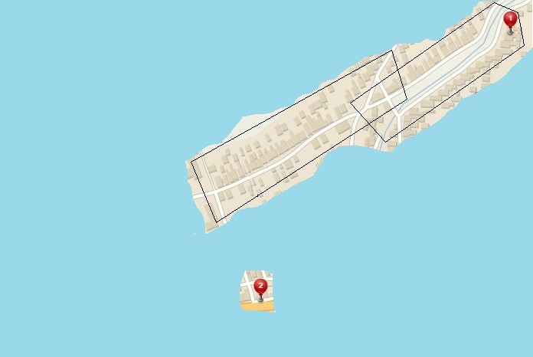
Look around, get know to your surroundings
This PATH can get me Closer
GOAL
Notes:
Now new patch of the territory has been revealed

Slide 17
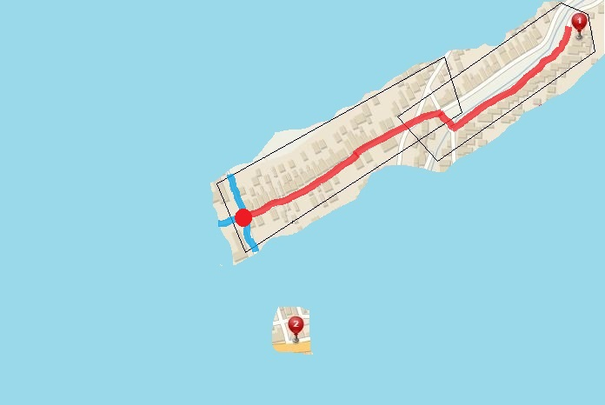
Walk a little more, get closer to the Restaurant
Rinse and repeat
Way 3
Passed trajectory
Way 2
Decision point
Way 1
GOAL
Notes:
Now Rinse and Repeat,
Same as before we get to Decision Point,
Three ways lies ahead only one leads to Goal

Slide 18
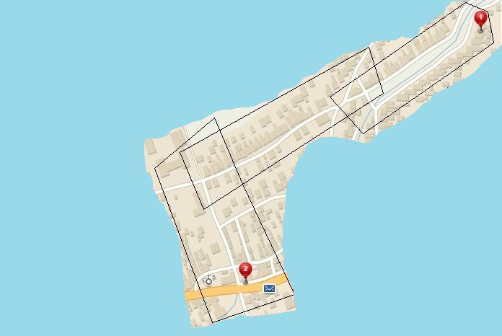
Now Gentleman can see the Restaurant
GET to the Restaurant
GOAL
I can see the way
to the Restaurant
Notes:
Now we take the right way,
We can see a Goal of our journey …

Slide 19
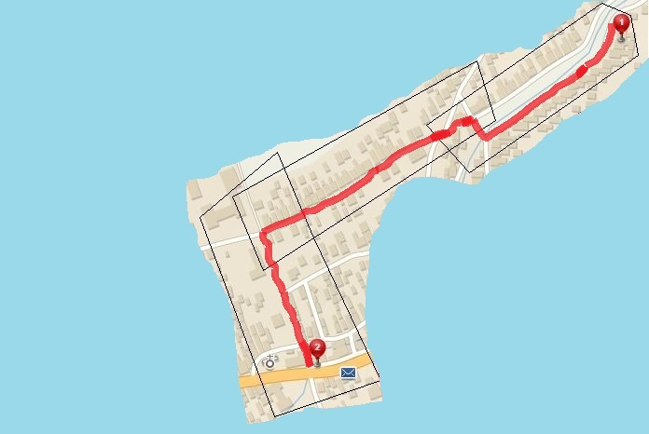
Enjoy a Pint
[P2] Evolving world:
SEMI-Optimal navigation to GOAL
Less optimal than [1]
Your destination is at the right side of the road
Notes:
Just Reach it and we are fine,
Evolving world challenge has been passes,
The Path was not as optimal as in case when we had a map, but we did it
Now lets make life harder again.

Slide 20
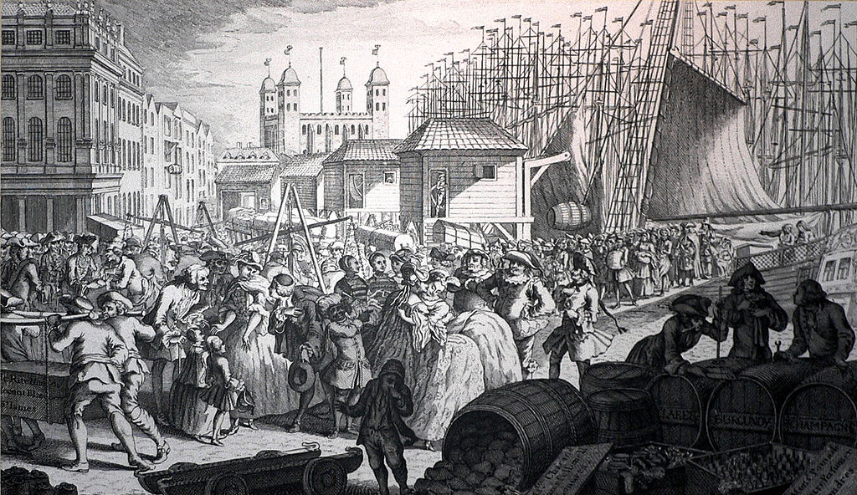

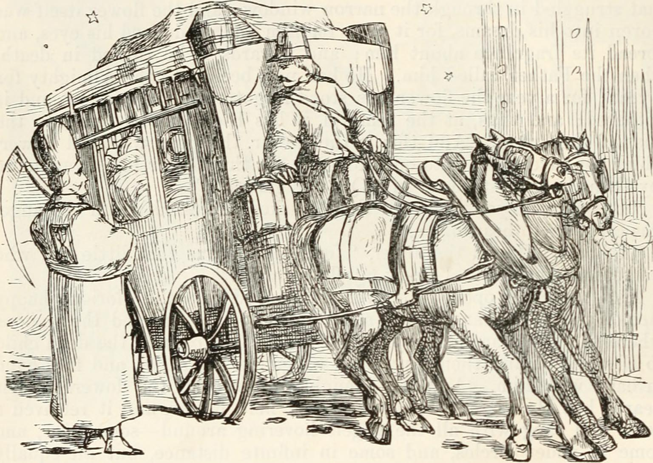
You are NOT alone on the streets !
[P3] Adversarial:
You need to avoid:
Carriages and Other people
You can hurt others !
[P3] Adversarial:
Reactive obstacle avoidance
Ingredients:
Intruder Position
Intruder Velocity
Own position and velocity
Notes:
You are not alone on streets nor in the Airspace.
There are Adversaries, people and Carriages, whom wants to take your sweet spot on the road.
You can use your cat like reflexes to avoid them, you just need to know:
Their position and heading velocity
Your own intentions
Now lets make life even harder,

Slide 21
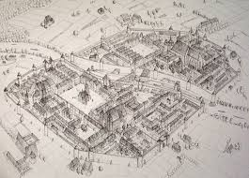
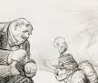
Multiple source of information – Data Fusion
[P3] Data fusion:
So much Information …
So many Whispers …
Need Validation …
Much Verification …
[P3] Data Fusion:
Decisions under uncertainty
Determine what is truth
Consider all information
Rank your sources worth
Notes:
You bought a new map, which is not very precise, but still reliable,
You heard many rumors and much more stuff from officials,
You need to clean your head to make a right choice, what is true what is good,
Do not worry my friend Data Fusion is here to help

Slide 22
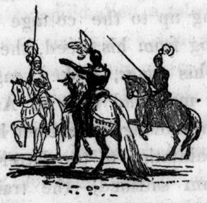

Vigilantes & Grannies – Static restriction areas
[P3] Static restrictions:
Vigilantes will kill you …
Grannies will tell your grandmother ….
[P3] Static restrictions:
You can break it, but you
will pay
TERRIBLE PRICE !
Try to avoid all restricted areas
Notes:
There is a space which is occupied by various groups,
One are kind like Grannies, whom only tell your Grand mother that you get into Fine restaurant
Other are not so kind, like Vigilante Knights which will kill you on the spot (What did you expected from dark ages ?)

Slide 23
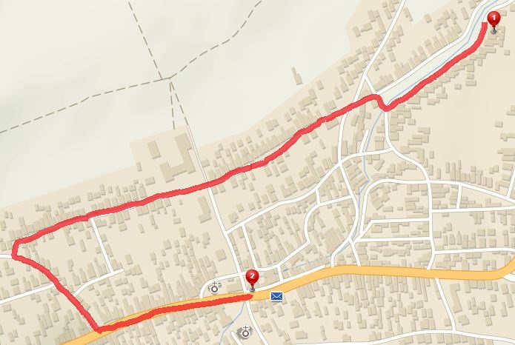
Try to avoid static restrictions areas !
[5] Static restrictions:
Avoid them all !
Vigilante
Grannies
Notes:
Let see the situation on the map, The occupied territory is marked for each group,
The large detour was taken to avid both of them.
Now every problem in Avoidance topic should be addressed right ?
How about weather ?

Slide 24


How about weather ?
[P4] Weather:
Östlichesburg winter very harsh,
On the other hand,
Östlichesburg summer even Harsher
[P4] Weather:
Harsh Weather Avoid NOW !
Maybe you will need to break some restrictions
Notes:
Weather is bad for our skin, so we try to avoid bad weather,

Slide 25
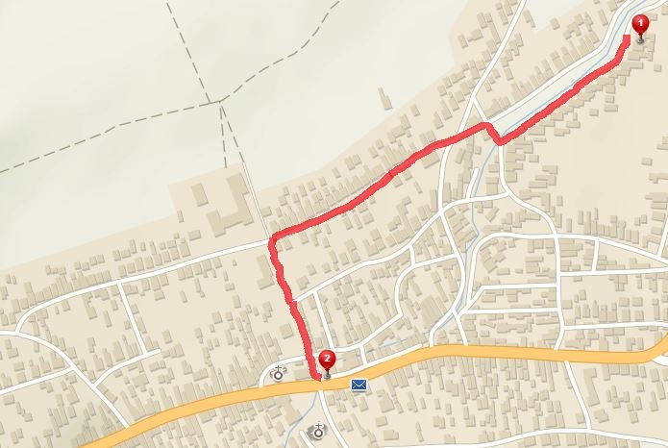
Rather get caught, than catching cold …
[P4] Weather:
You will avoid Snowstorm,
But you will answer to Grandmother call …
Snowstorm
I will explain somehow…
Vigilante
Heatwave
Grannies
Notes:
Dark ages weather was very harsh and very localized,
We have
snowstorm on the left
Heatwave on the right
Do not worry Grannies and Vigilante is still there, so what now …
We need to break some restrictions and avoid harsher conditions …
There is one more thing to address …

Slide 26
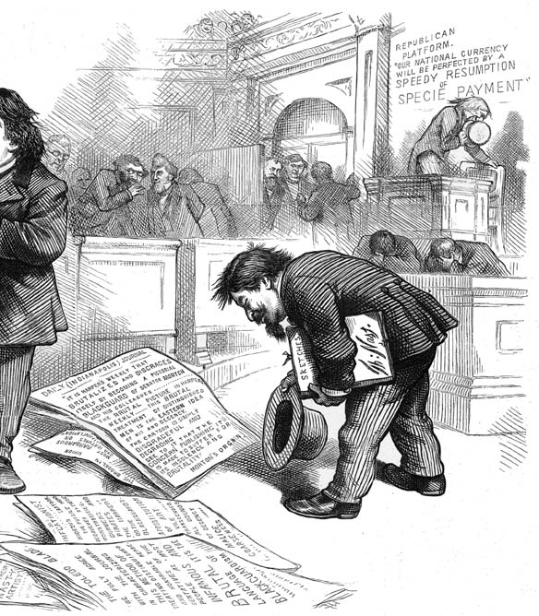
Stick to the rules !
[P5] Rules:
Obey rules while walking
[P5] Rules:
Stick to Written and unwritten rules …
Necessity
for integration into traffic,
society,
air space
Notes:
You just need to stick to the rules,
Society Norm, traffic regulations, airspace rules and so on ….

Slide 27
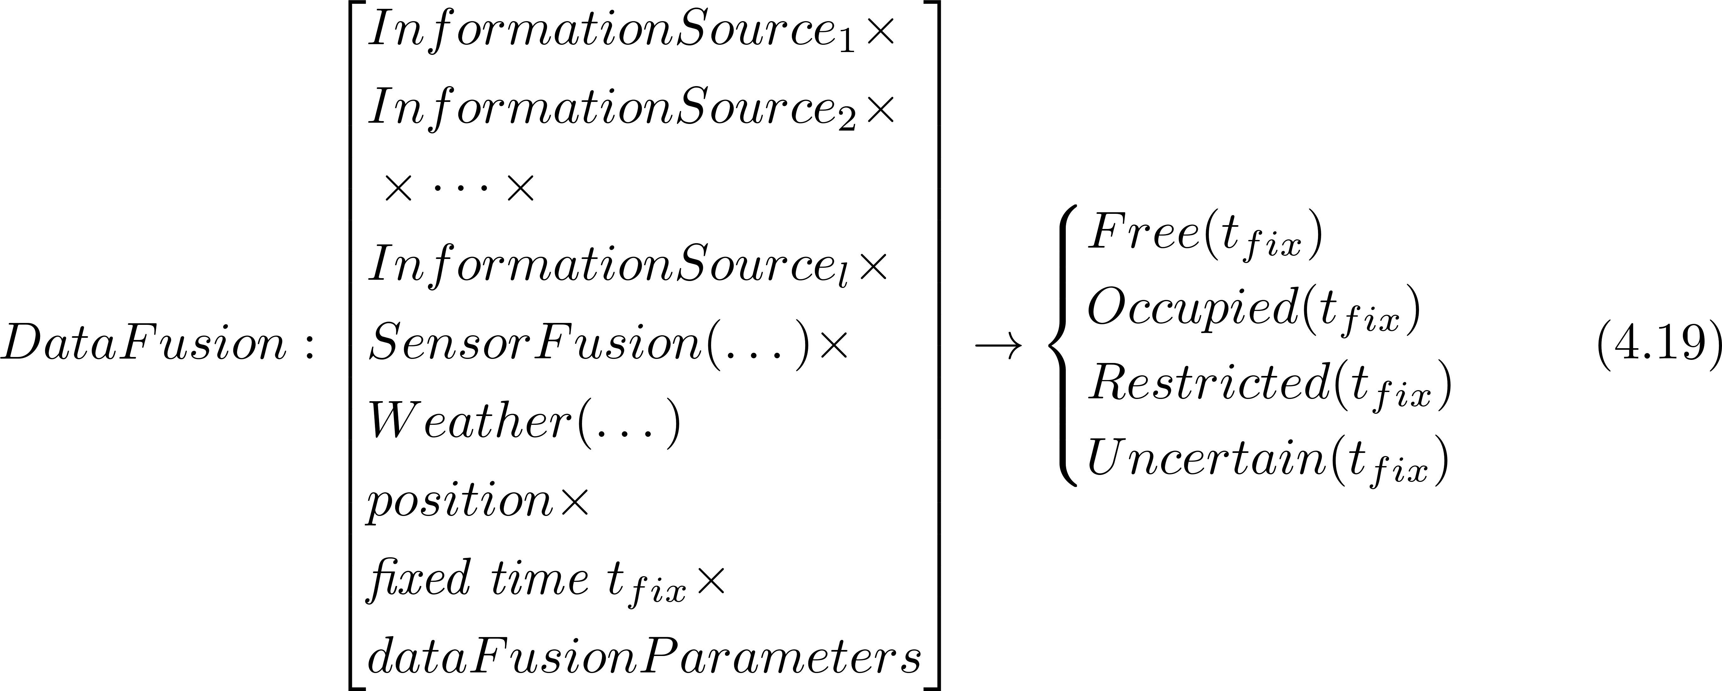
Formal problem specification 1/2
The UAS is operating in space classified into four distinctive subsets:
The space classification is coming from data fusion procedure:

Slide 28
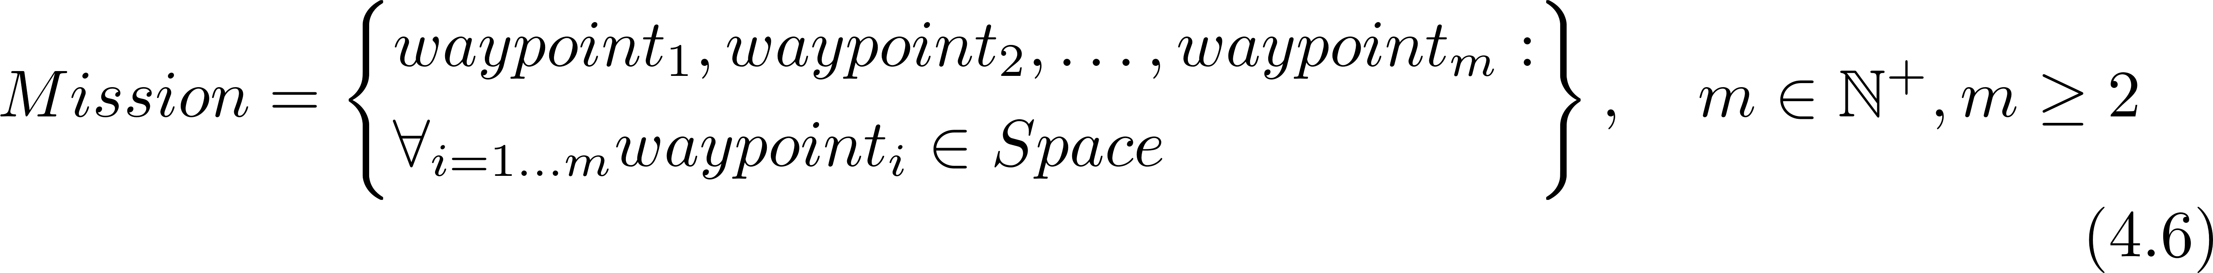
Formal problem specification 2/2
UAS will fly a Mission given as ordered set of waypoints:
The goal is to have path satisfying:
Under the assumptions:
Filtered sensor reading are available.
There are no moving obstacles (intruders) [Relaxed P3]
The movement takes place in unrestricted airspace [Relaxed P5]
The mission consist of a set of reachable waypoints
The UAS is moving with constant velocity [Relaxed P5]

Slide 29
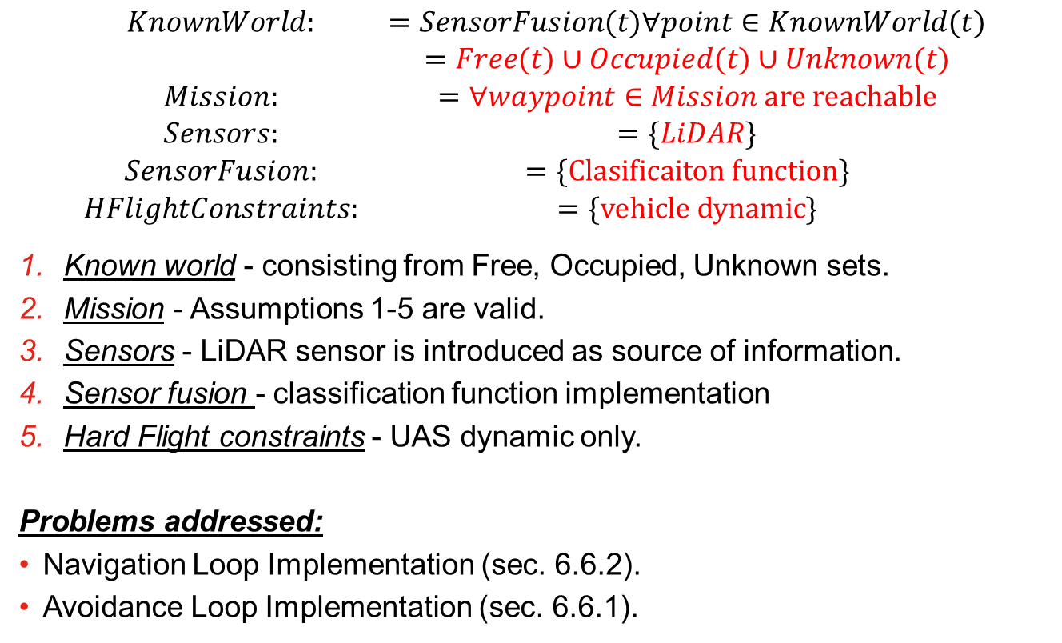
Incremental problem definition: [P1] Basic Avoidance
$$\begin{matrix}KnownWorld: & =SensorFusion(t)∀point∈KnownWorld(t) \\ & =Free(t)∪Occupied(t)∪Unknown(t) \\ Mission: & =∀waypoint∈Mission are reachable \\ Sensors: & =\{LiDAR\} \\ SensorFusion: & =\{Clasificaiton function\} \\ HFlightConstraints: & =\{vehicle dynamic\}\end{matrix}$$
Known world - consisting from Free, Occupied, Unknown sets.
Mission - Assumptions 1-5 are valid.
Sensors - LiDAR sensor is introduced as source of information.
Sensor fusion - classification function implementation
Hard Flight constraints - UAS dynamic only.
Problems addressed:
Navigation Loop Implementation (sec. 6.6.2).
Avoidance Loop Implementation (sec. 6.6.1).

Slide 30
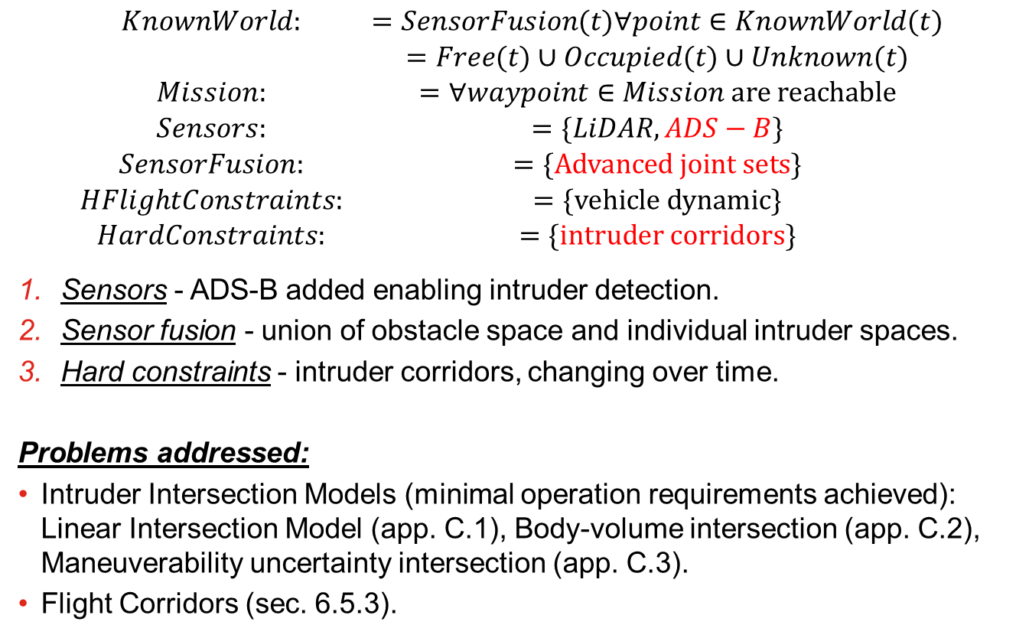
Incremental problem definition: [P2] Intruders Introduction
$$\begin{matrix}KnownWorld: & =SensorFusion(t)∀point∈KnownWorld(t) \\ & =Free(t)∪Occupied(t)∪Unknown(t) \\ Mission: & =∀waypoint∈Mission are reachable \\ Sensors: & =\{LiDAR,ADS−B\} \\ SensorFusion: & =\{Advanced joint sets\} \\ HFlightConstraints: & =\{vehicle dynamic\} \\ HardConstraints: & =\{intruder corridors\}\end{matrix}$$
Sensors - ADS-B added enabling intruder detection.
Sensor fusion - union of obstacle space and individual intruder spaces.
Hard constraints - intruder corridors, changing over time.
Problems addressed:
Intruder Intersection Models (minimal operation requirements achieved): Linear Intersection Model (app. C.1), Body-volume intersection (app. C.2), Maneuverability uncertainty intersection (app. C.3).
Flight Corridors (sec. 6.5.3).

Slide 31
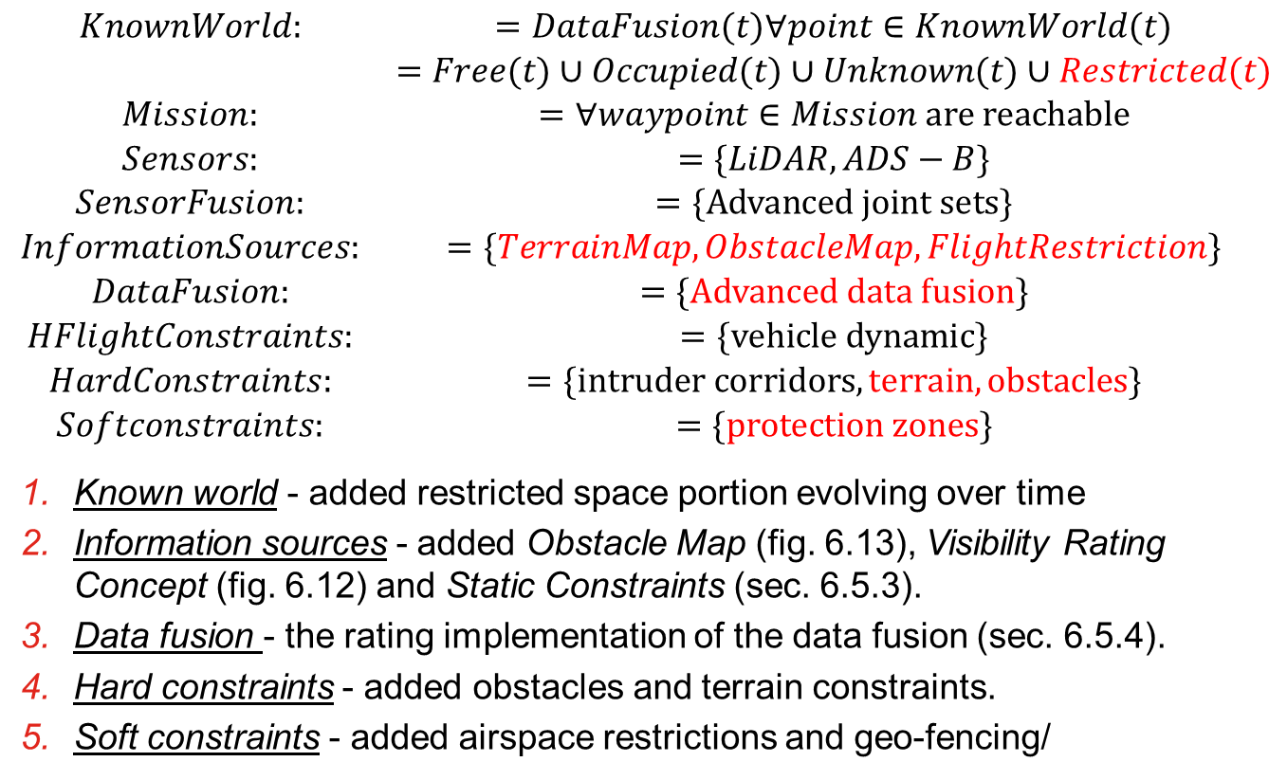
Incremental problem definition: [P3] Static restrictions
$$\begin{matrix}KnownWorld: & =DataFusion(t)∀point∈KnownWorld(t) \\ & =Free(t)∪Occupied(t)∪Unknown(t)∪Restricted(t) \\ Mission: & =∀waypoint∈Mission are reachable \\ Sensors: & =\{LiDAR,ADS−B\} \\ SensorFusion: & =\{Advanced joint sets\} \\ InformationSources: & =\{TerrainMap,ObstacleMap,FlightRestriction\} \\ DataFusion: & =\{Advanced data fusion\} \\ HFlightConstraints: & =\{vehicle dynamic\} \\ HardConstraints: & =\{intruder corridors,terrain,obstacles\} \\ Softconstraints: & =\{protection zones\}\end{matrix}$$
Known world - added restricted space portion evolving over time
Information sources - added Obstacle Map (fig. 6.13), Visibility Rating Concept (fig. 6.12) and Static Constraints (sec. 6.5.3).
Data fusion - the rating implementation of the data fusion (sec. 6.5.4).
Hard constraints - added obstacles and terrain constraints.
Soft constraints - added airspace restrictions and geo-fencing/

Slide 32
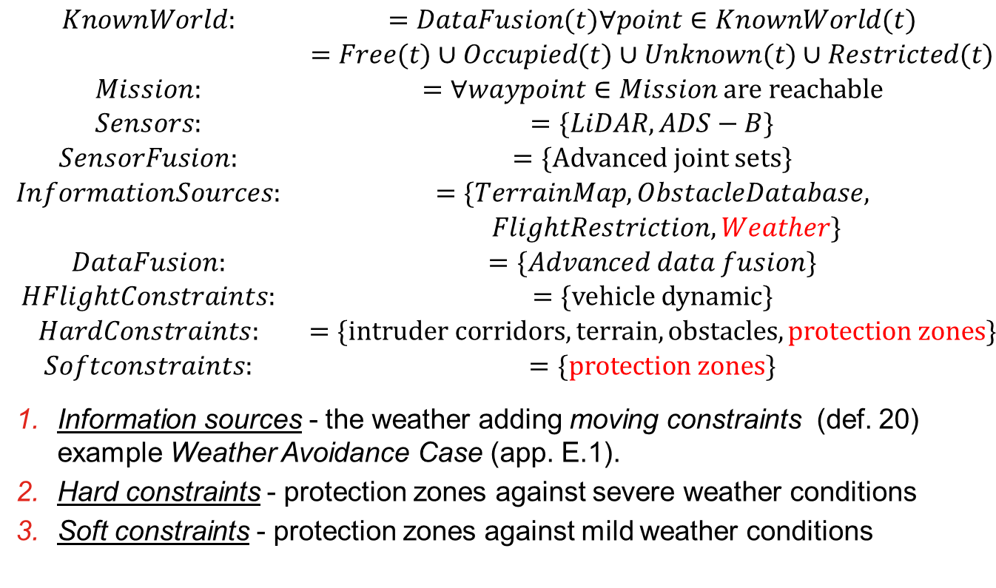
Incremental problem definition: [P4] Dynamic restrictions
$$\begin{matrix}KnownWorld: & =DataFusion(t)∀point∈KnownWorld(t) \\ & =Free(t)∪Occupied(t)∪Unknown(t)∪Restricted(t) \\ Mission: & =∀waypoint∈Mission are reachable \\ Sensors: & =\{LiDAR,ADS−B\} \\ SensorFusion: & =\{Advanced joint sets\} \\ InformationSources: & =\{TerrainMap,ObstacleDatabase, \\ & FlightRestriction,Weather\} \\ DataFusion: & =\{Advanced data fusion\} \\ HFlightConstraints: & =\{vehicle dynamic\} \\ HardConstraints: & =\{intruder corridors,terrain,obstacles, protection zones\} \\ Softconstraints: & =\{protection zones\}\end{matrix}$$
Information sources - the weather adding moving constraints (def. 20) example Weather Avoidance Case (app. E.1).
Hard constraints - protection zones against severe weather conditions
Soft constraints - protection zones against mild weather conditions

Slide 33
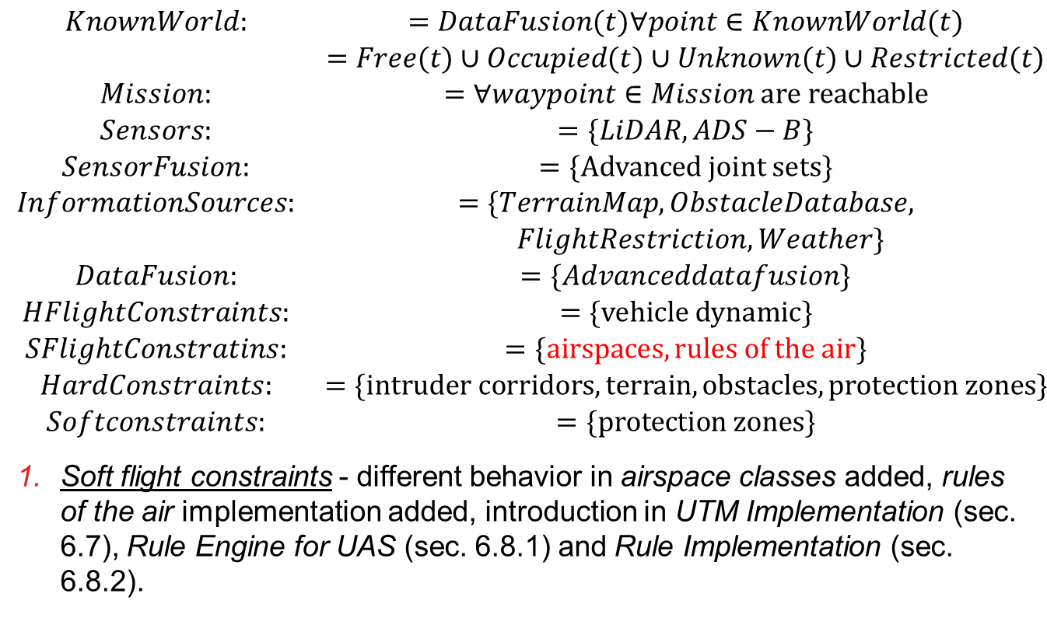
Incremental problem definition: [P5] Rules of the air
$$\begin{matrix}KnownWorld: & =DataFusion(t)∀point∈KnownWorld(t) \\ & =Free(t)∪Occupied(t)∪Unknown(t)∪Restricted(t) \\ Mission: & =∀waypoint∈Mission are reachable \\ Sensors: & =\{LiDAR,ADS−B\} \\ SensorFusion: & =\{Advanced joint sets\} \\ InformationSources: & =\{TerrainMap,ObstacleDatabase, \\ & FlightRestriction,Weather\} \\ DataFusion: & =\{Advanceddatafusion\} \\ HFlightConstraints: & =\{vehicle dynamic\} \\ SFlightConstratins: & =\{airspaces, rules of the air\} \\ HardConstraints: & =\{intruder corridors,terrain,obstacles, protection zones\} \\ Softconstraints: & =\{protection zones\}\end{matrix}$$
Soft flight constraints - different behavior in airspace classes added, rules of the air implementation added, introduction in UTM Implementation (sec. 6.7), Rule Engine for UAS (sec. 6.8.1) and Rule Implementation (sec. 6.8.2).

Slide 34
Related work: Movement Automaton Surveillance Navigation Reach set estimation
Notes:
There are two modes Cooperative and non cooperative,
our solution supports both

Slide 35
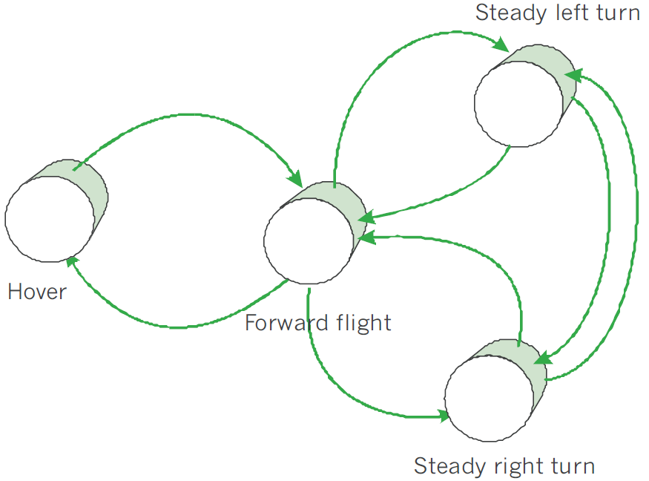
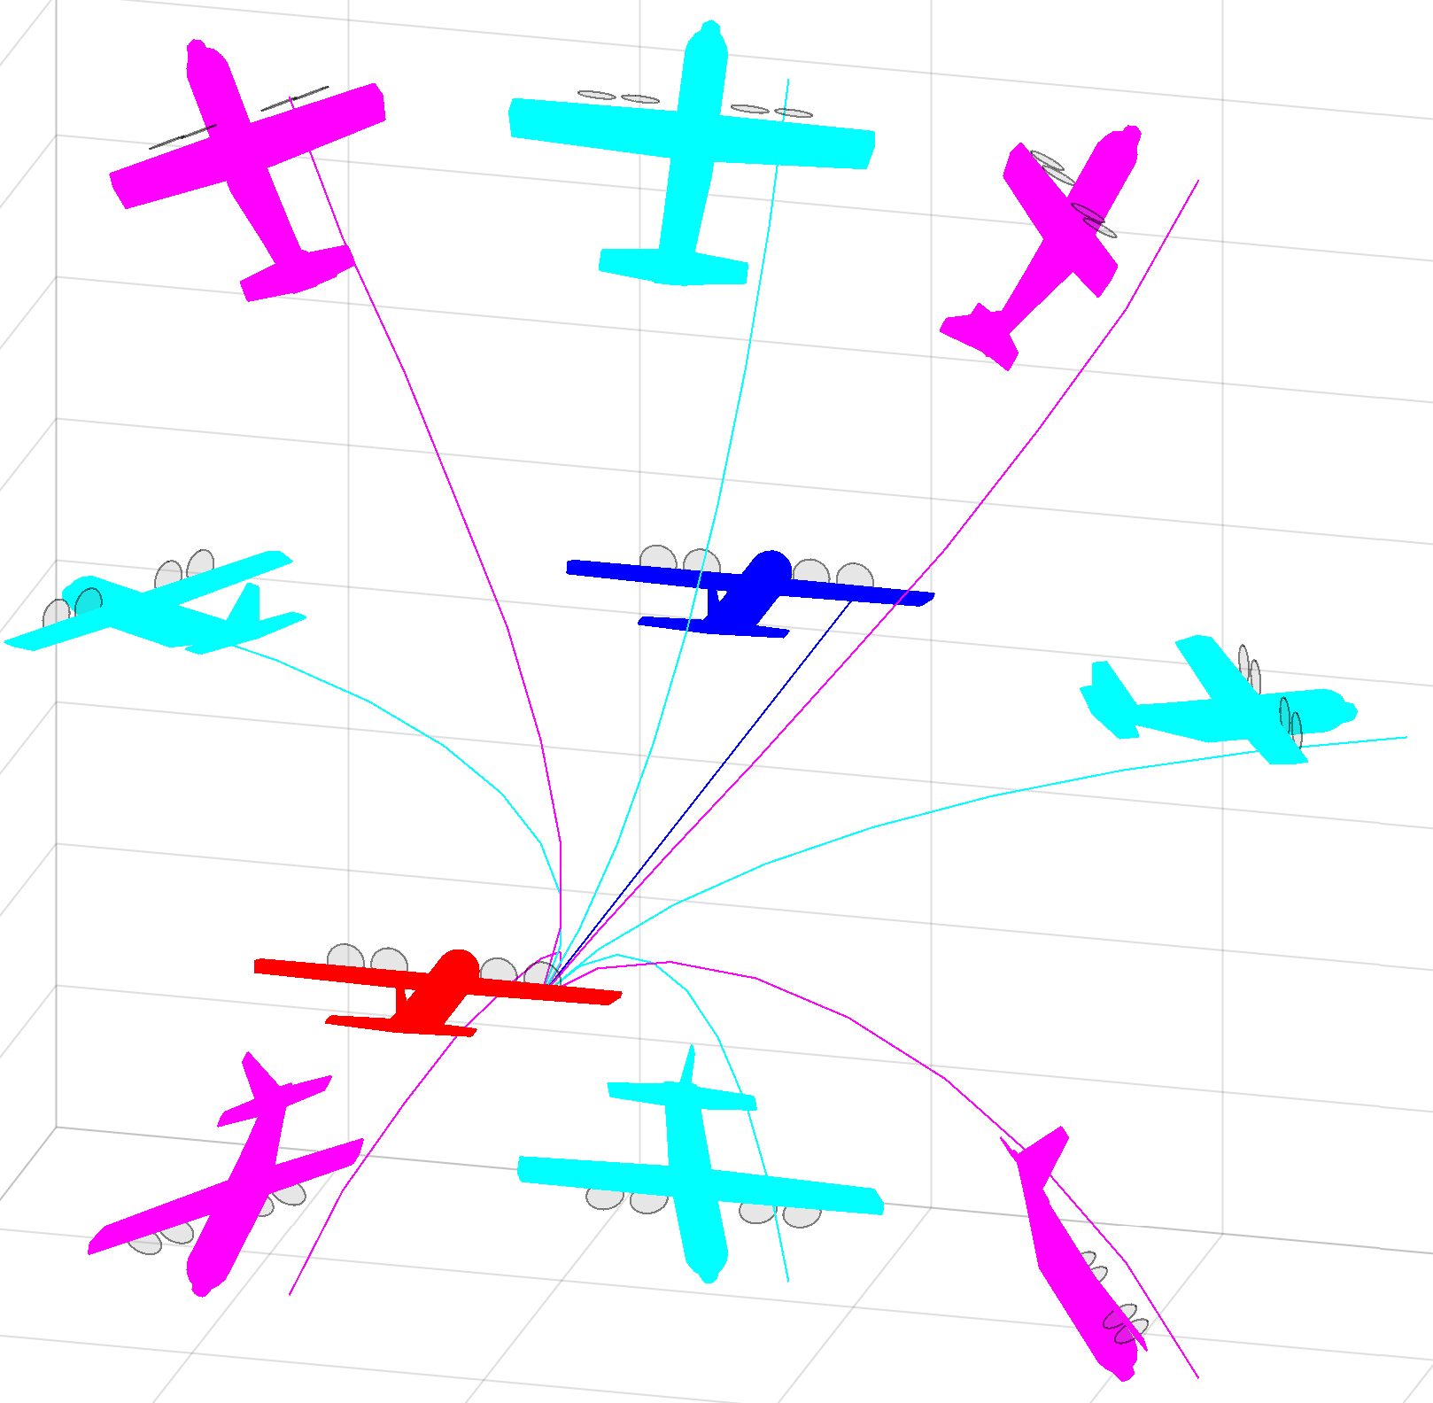
Related work: Movement automaton (5.1)
Related work:
[15] Emilio Frazzoli. Robust hybrid control for autonomous vehicle motion planning. PhD thesis, Massachusetts Institute of Technology, 2001.
[91] Emilio Frazzoli, Munther A Dahleh, and Eric Feron. Trajectory tracking control design for autonomous helicopters using a backstepping algorithm. In American Control Conference, 2000. Proceedings of the 2000, volume 6, pages 4102{4107. IEEE, 2000.

Slide 36
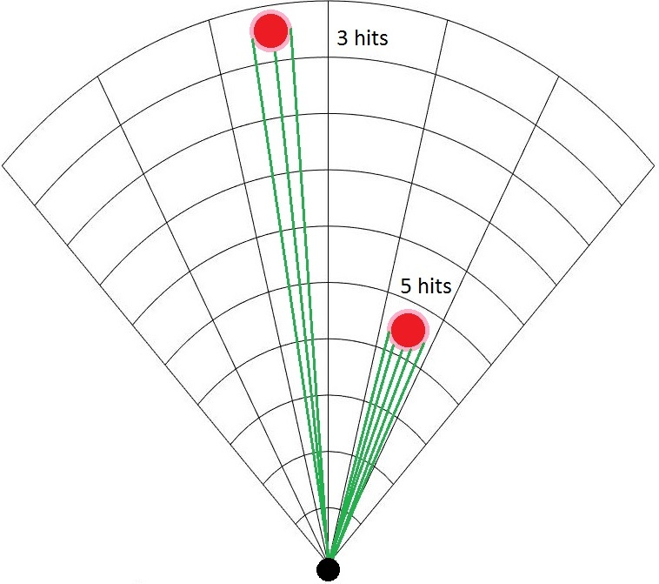
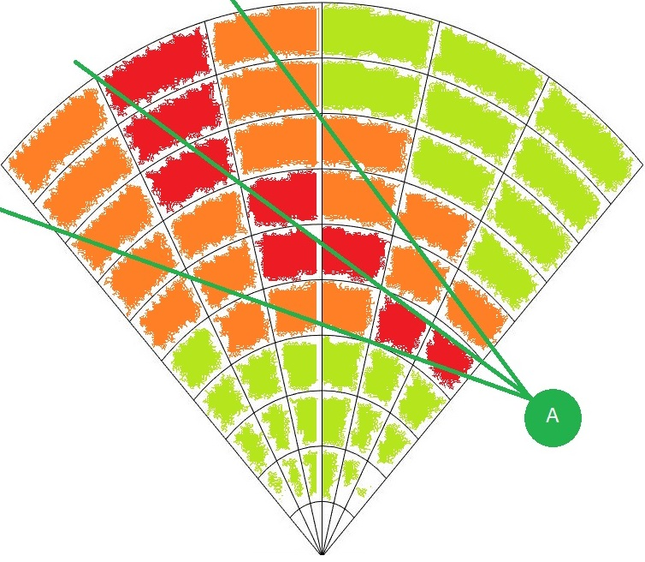
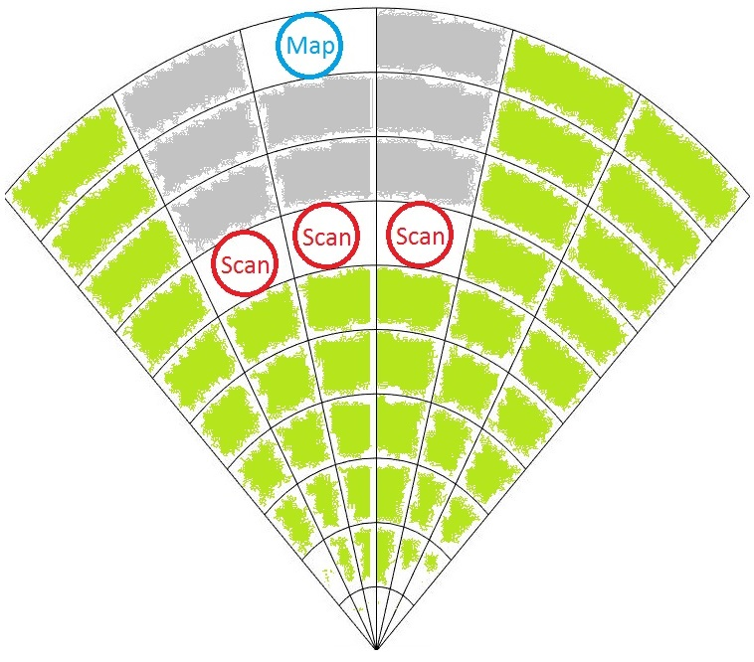
Related work: Surveillance (5.2)
Related work:
[98] Fredrik Gustafsson. Statistical sensor fusion. Studentlitteratur, 2010.
[99] Subramanian Ramasamy, Roberto Sabatini, Alessandro Gardi, and Trevor Kistan.
Next generation fight management system for real-time trajectory based
operations. Applied Mechanics and Materials, 629:344-349, 2014.
[100] Yuriy Chynchenko, Tatyana Shmelova, and Oksana Chynchenko. Remotely
piloted aircraft systems operations under uncertainty conditions. Proceedings of
the National Aviation University, 1(1):18-22, 2016.
[101] T Shmelova, D Bondarev, and Y Znakovska. Modeling of the decision making by
UAS operator in emergency situations. In Methods and Systems of Navigation
and Motion Control (MSNMC), 2016 4th International Conference on, volume 1,
pages 31-34. IEEE, 2016.

Slide 37
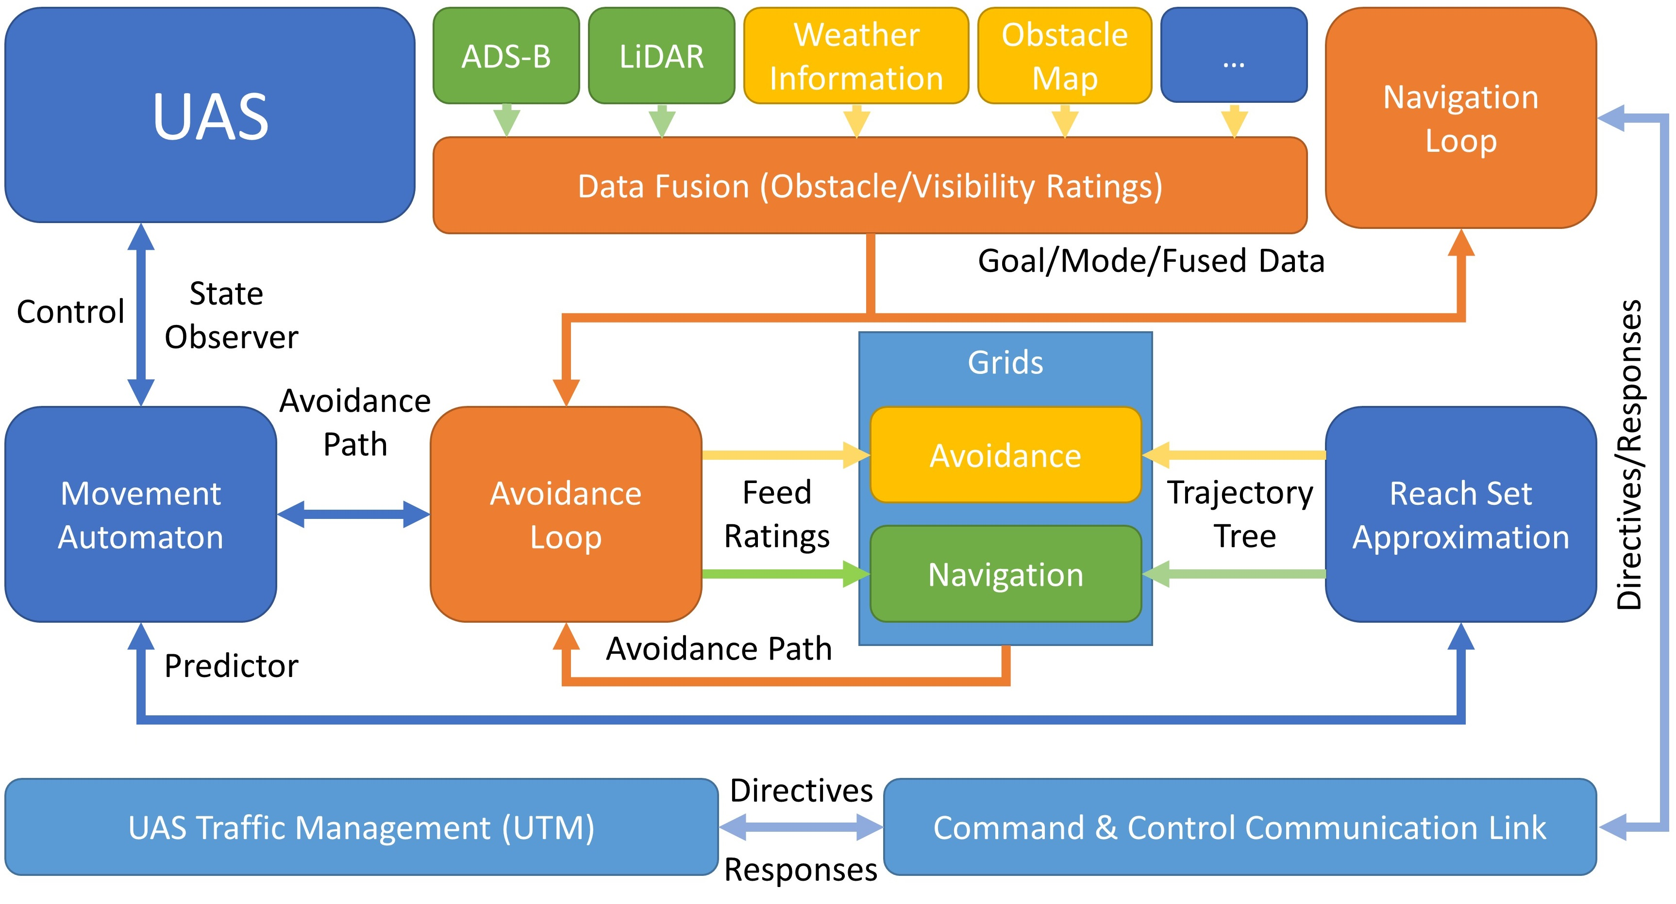
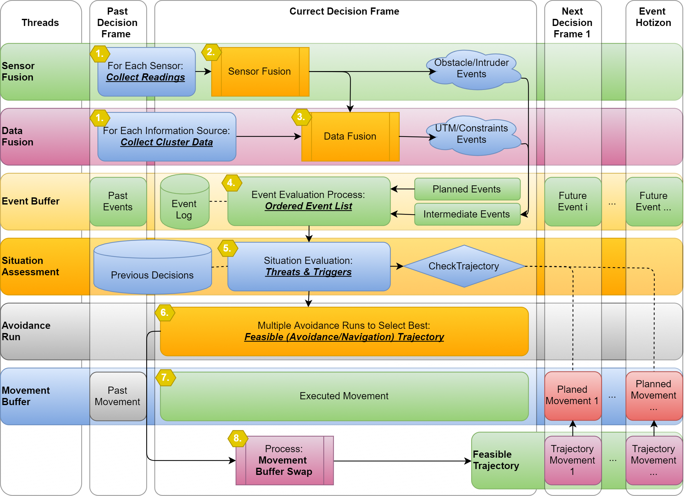
Related work: Navigation (5.3)
Related work:
[167] Roberto Sabatini, Celia Bartel, Anish Kaharkar, Tesheen Shaid, and
Subramanian Ramasamy. Navigation and guidance system architectures for
small unmanned aircraft applications. International Journal of Mechanical,
Industrial Science and Engineering, 8(4):733-752, 2014.
[168] Roberto Sabatini, Alessandro Gardi, and M Richardson. Lidar obstacle warning
and avoidance system for unmanned aircraft. International Journal of
Mechanical, Aerospace, Industrial and Mechatronics Engineering, 718-729,2014.

Slide 38
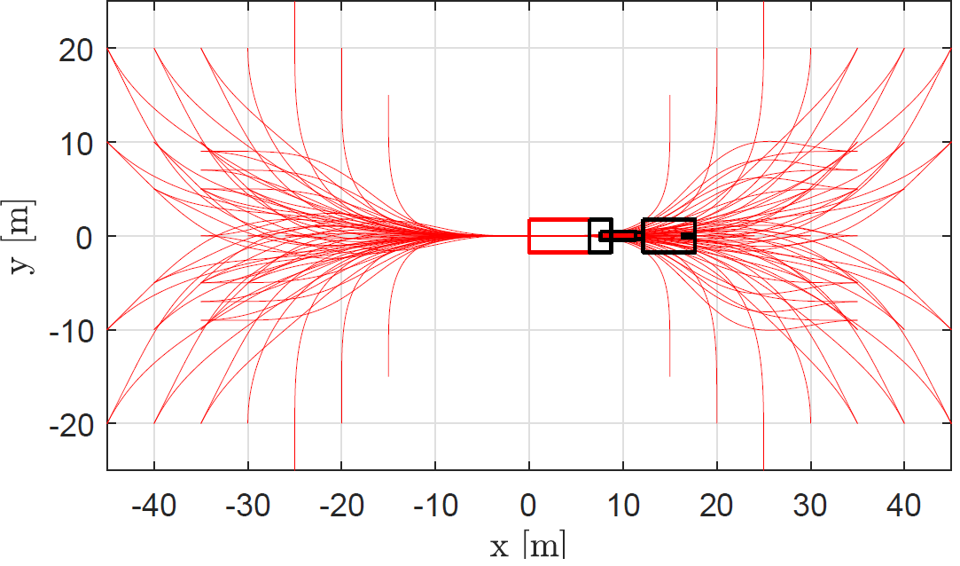
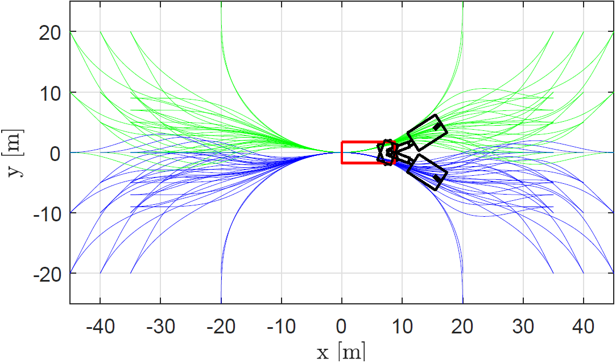
Related work: Reach Set Estimation (5.4)
Related work:
[108] Steven M LaValle, Michael S Branicky, and Stephen R Lindemann. On the
relationship between classical grid search and probabilistic roadmaps. The
International Journal of Robotics Research, 23(7-8):673-692, 2004.
[109] Ira M Gessel. A probabilistic method for lattice path enumeration. Journal of
statistical planning and inference, 14(1):49-58, 1986.
[110] Floriana Esposito, Donato Malerba, Giovanni Semeraro, and J Kay. A
comparative analysis of methods for pruning decision trees. IEEE transactions
on pattern analysis and machine intelligence, 19(5):476{491, 1997.

Slide 39
Proposed Framework: Overview Avoidance Run UTM Implementation Rule Engine
Notes:
Let us look at the “Magic” which I mentioned Earlier.

Slide 40


Proposed framework Overview
Navigation Loop
Data Fusion
ADS-B
Situation Assessment
Events
Triggers
LiDAR
Goal Waypoint
Weather
Directives
Changes
Directives
Avoidance Run
Avoidance Grid
Map
Avoidance Trajectory
Restrictions
Reach Set
Probabilities
Notes:
Navigation Loop Provides goal waypoint from mission plan
- taken from other work
- very simple
Data fusion is providing probabilistic assessment of situation from following data sources:
- ADS-B for intruders
Lidar for static obstacles and adversaries
Weather constraints
Control authority directives
Map of obstacles
Restrictions – Geo fencing and others static restritions
These data sources are basically a static and dynamic constraints for UAS
Situation assessment – own module
- Outside Events - ex. new intruder arrival
- Internal Triggers – ex. reach of decision point
- Valid Directives – ex. Geofencing around Honeywell CZ27 building
- Probabilistic situation changes are evaluated – ex increase of danger of bird collision …
It triggers a Avoidance Run
Avoidance Run (Own work) does what I described just not …

Slide 41
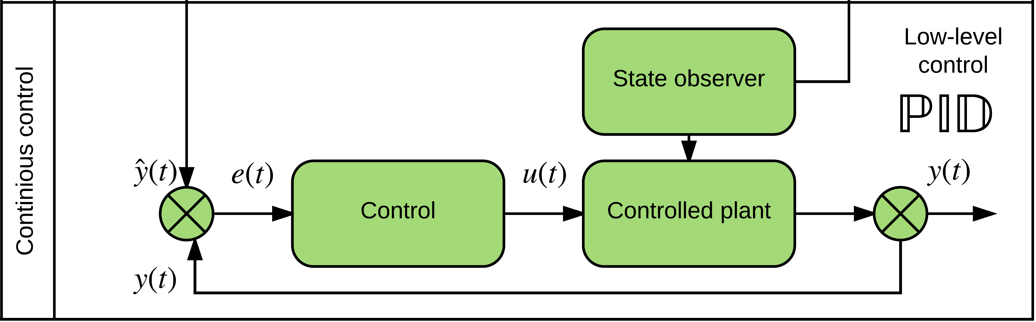
UAS model
ADS-B
Obstacle Map
LiDAR
Rule Engine
Data fusion
Mission Plan
Avoidance grid
UAS model
Movement Automaton
Reach set approximation
Notes:
Example of Vehicle control can be standard closed loop control
This has been implemented as prototype in Matlab

Slide 42
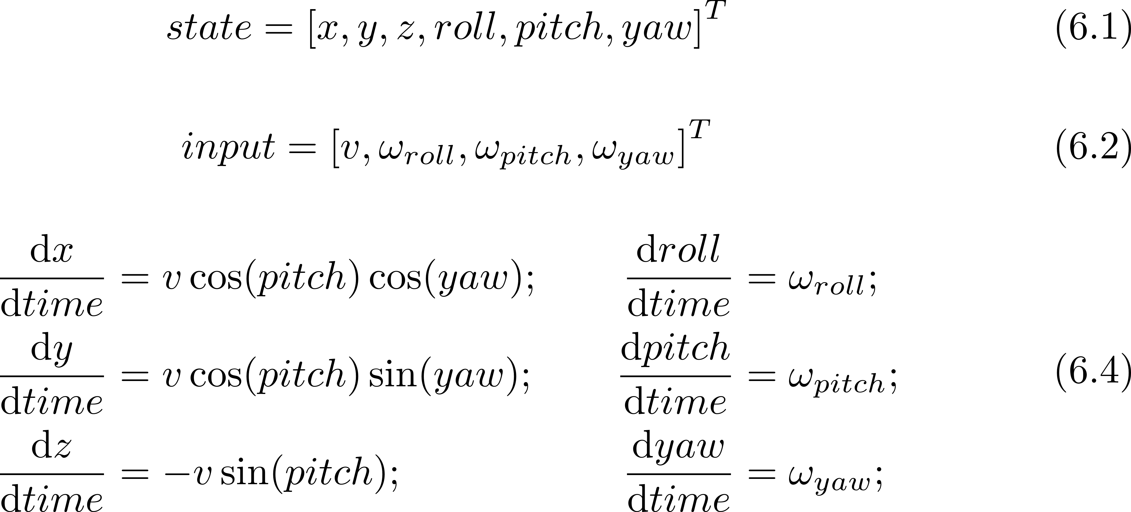
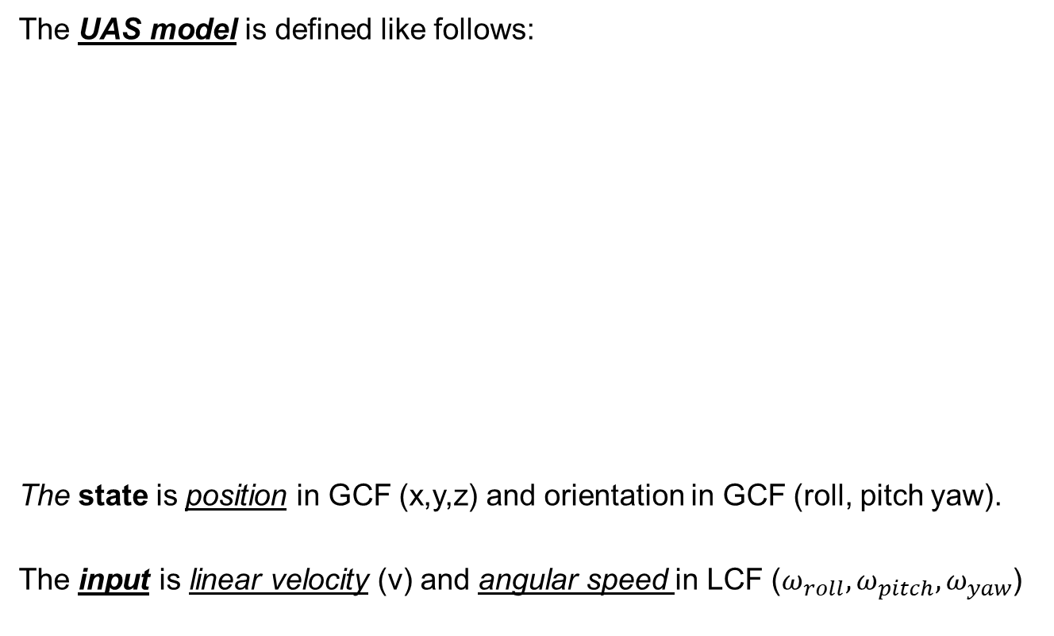
UAS model: 3D unicycle (6.2.2)
The UAS model is defined like follows:
The state is position in GCF (x,y,z) and orientation in GCF (roll, pitch yaw).
The input is linear velocity (v) and angular speed in LCF ($ω_{roll},ω_{pitch}, ω_{yaw}$)

Slide 43
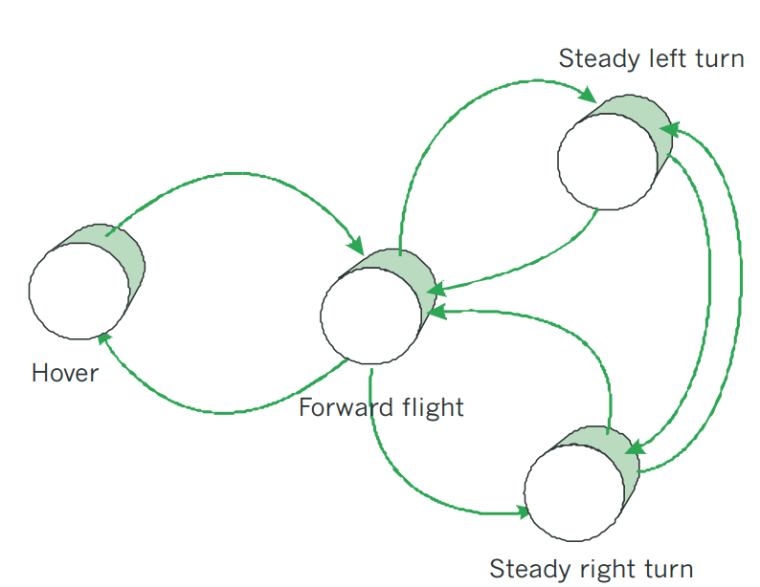
Movement Automaton
ADS-B
Obstacle Map
LiDAR
Rule Engine
Data fusion
Mission Plan
Avoidance grid
UAS model
Movement Automaton
Reach set approximation
Notes:
Movement automaton is interface acting between conventional control principles and discrete command chain
eg. Move left 2s, move strainght 2s

Slide 44
Movement Automaton: Movement set (6.2.3)
A movement set have been implemented containing movements lasting 1s:
The movement execution, with initial state represented as a red plane, looks like follow:

Slide 45
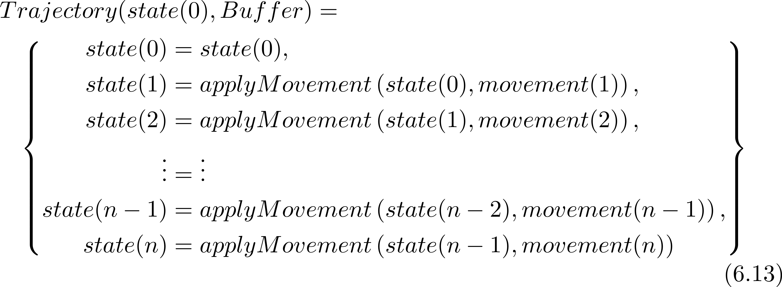
Movement Automaton: Trajectory (6.2.3)
A buffer is an ordered list of movements to be executed by UAS:
The trajectory for some initial state(0) and buffer is given as:

Slide 46
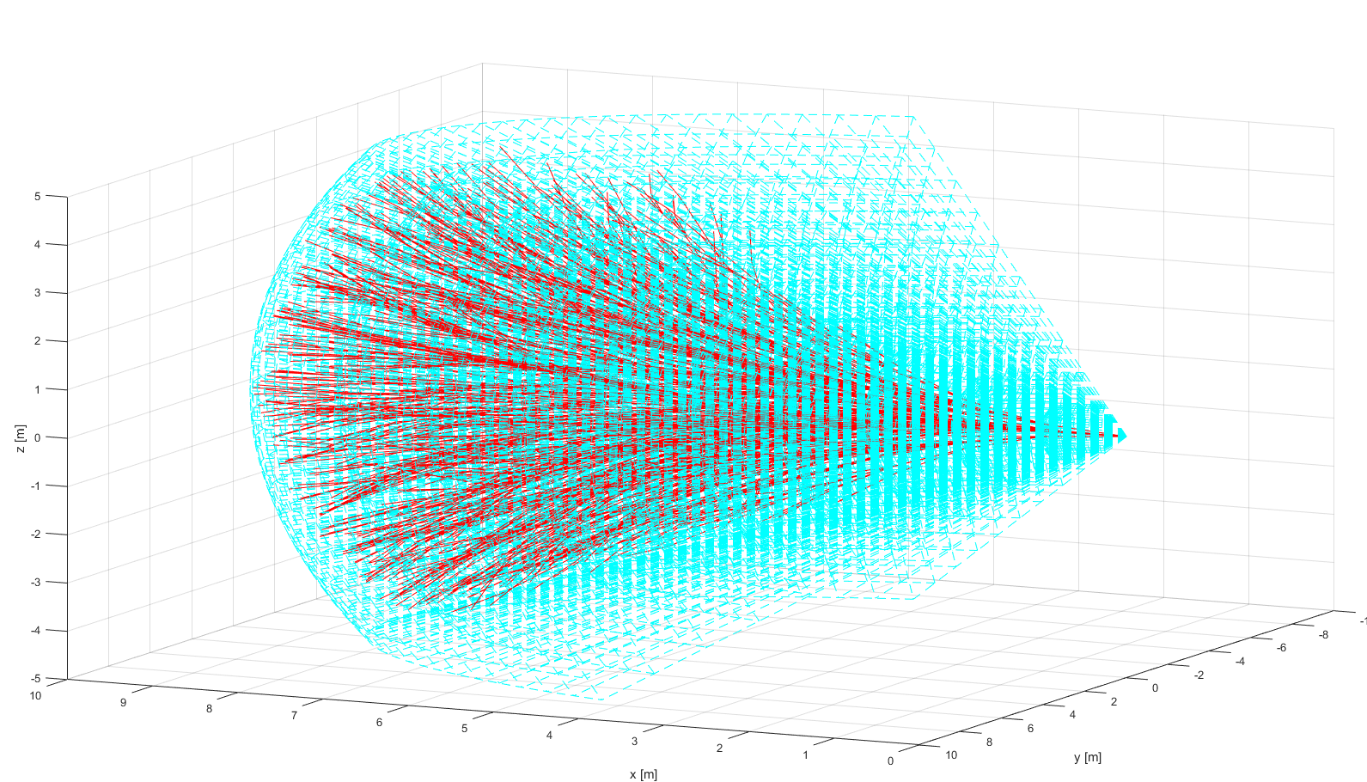
Reach set approximation
ADS-B
Obstacle Map
LiDAR
Rule Engine
Data fusion
Mission Plan
Avoidance grid
UAS model
Movement Automaton
Reach set approximation
Notes:
Example of reach set using my method (red) in Field of vision (aquamarine)
There has been implementation of prototype in Matlab (Deterministic version)

Slide 47
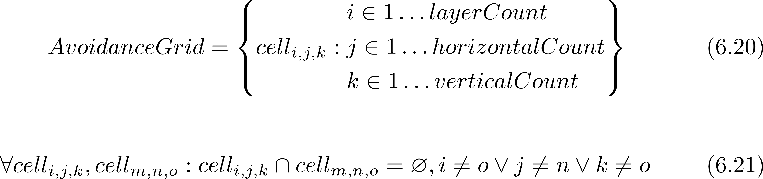
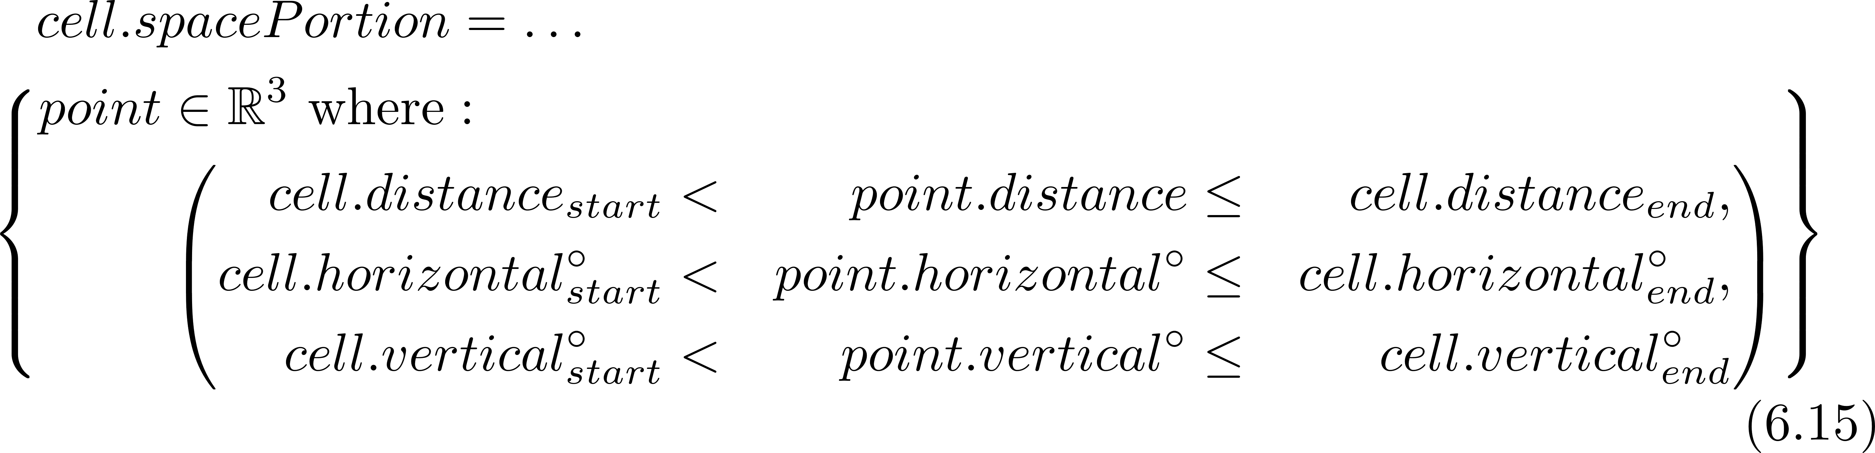
Reach set approximation Space segmentation – Avoidance Grid (6.3)
An intermediate operational space is segmented into avoidance grid:
One cell space portion is bounded by:
Refer to (def. 11,12)

Slide 48
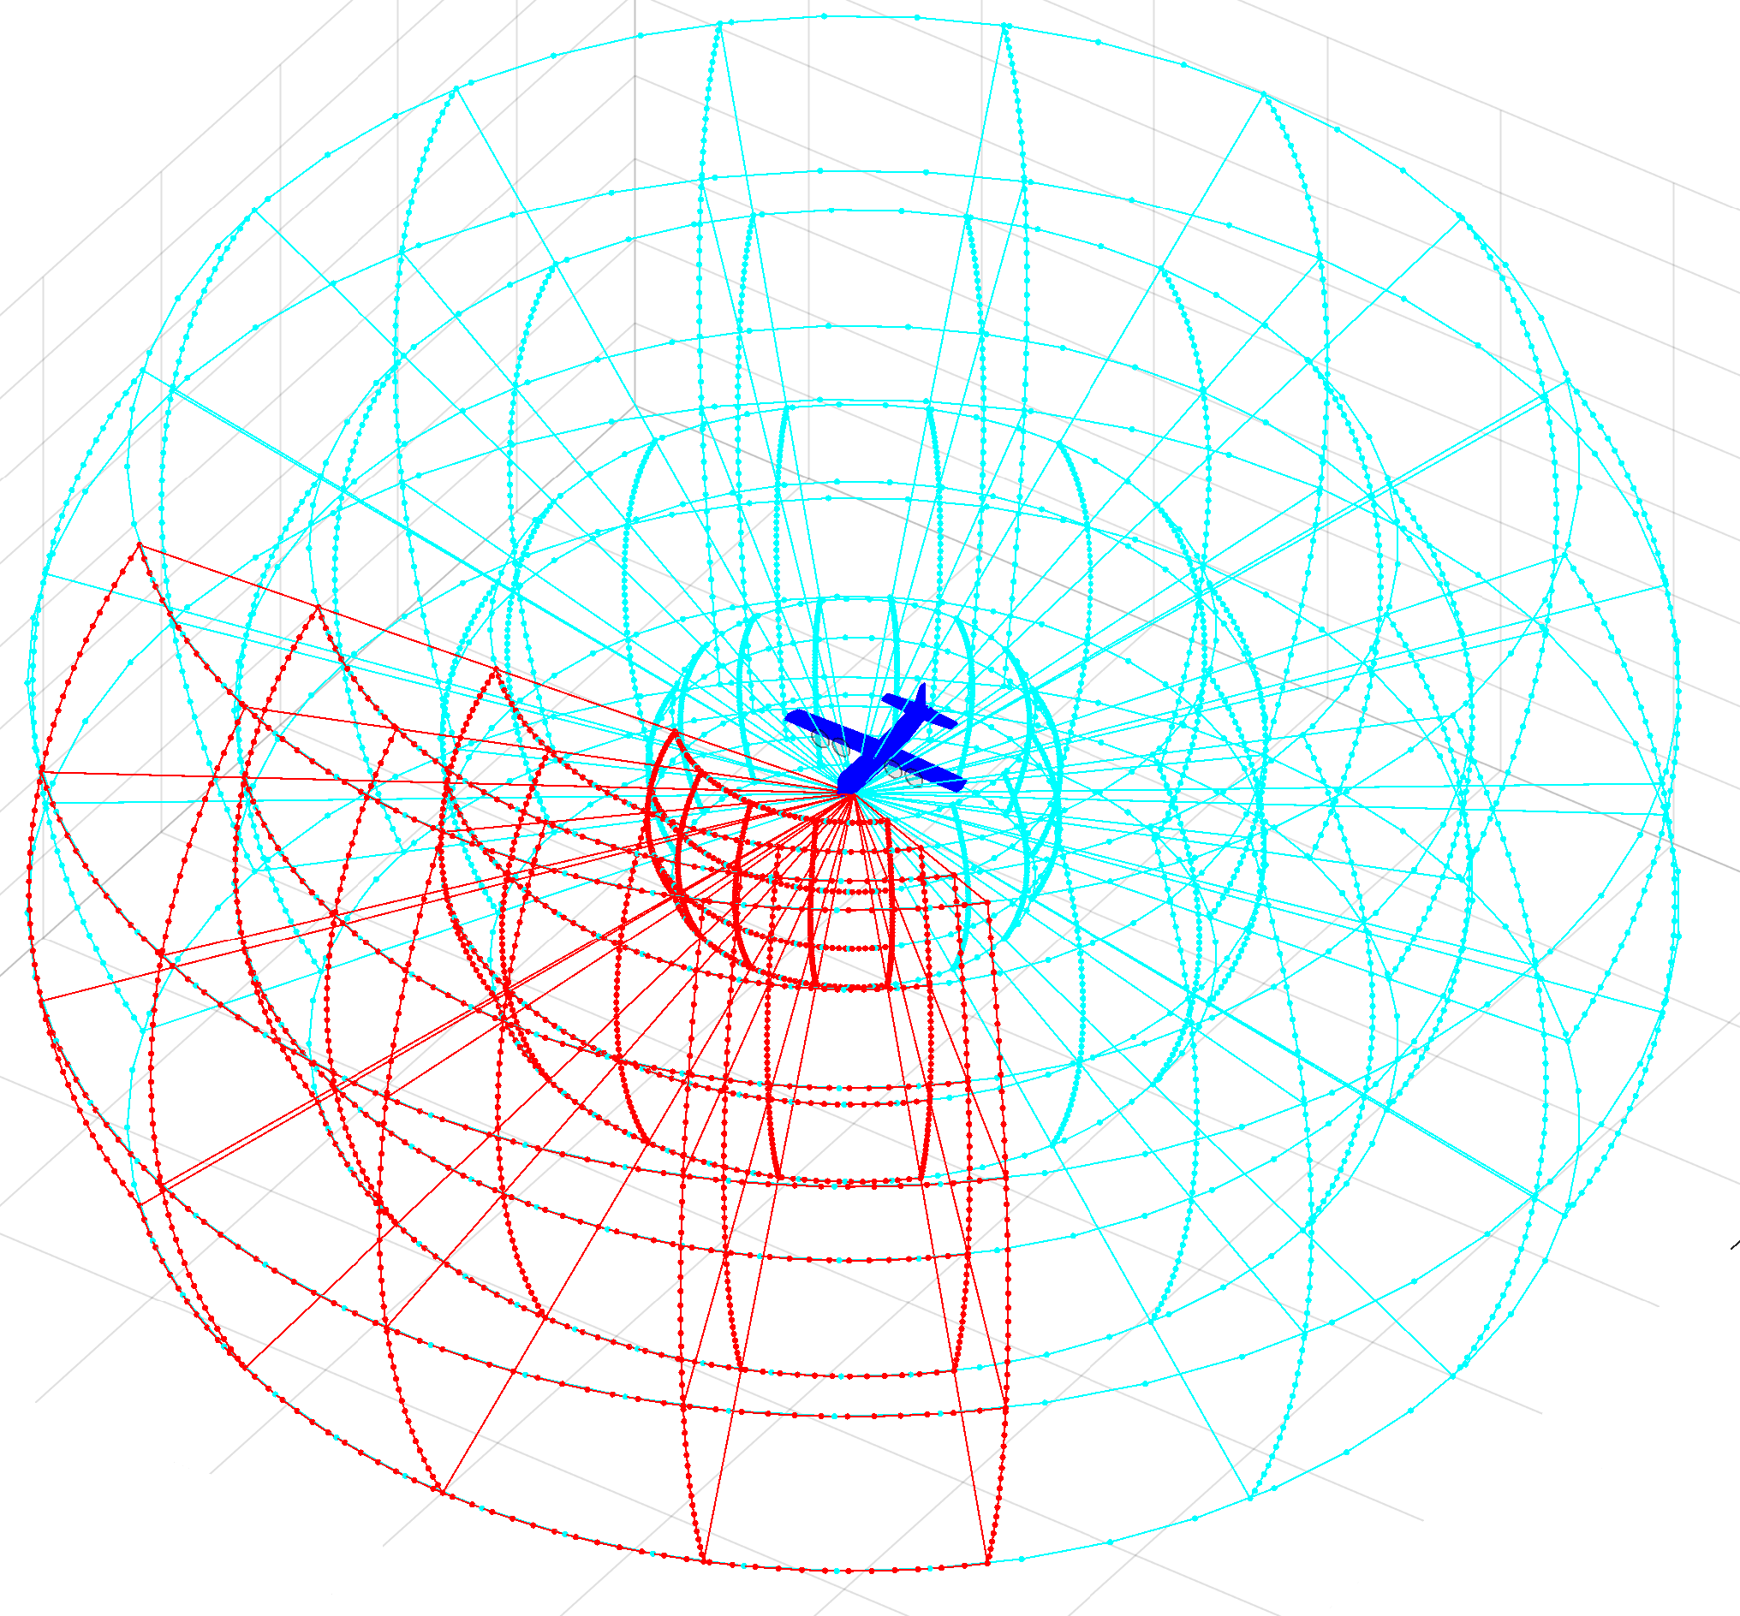
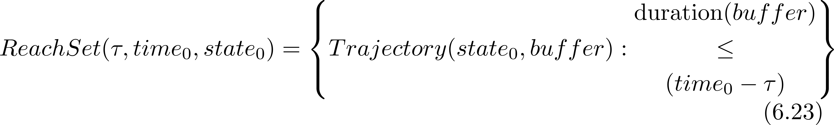
Reach set approximation The RSA definition
In segmented discrete operational space represented as avoidance grid:
The reach set approximation is a set of trajectories with common origin:

Slide 49
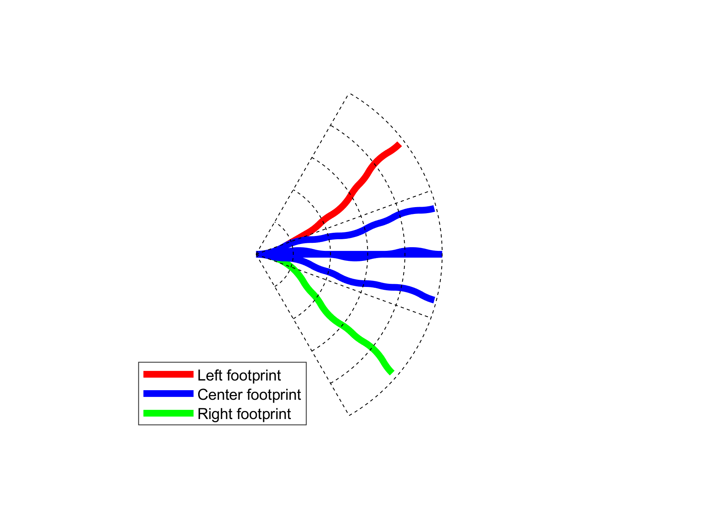

Reach set approximation: Trajectory properties (6.4.2)
Coverage – the trajectory footprint
6 trajectories 3 unique footprints
Turn ratio – count of turning movements
Try to minimize turning in reach set !
Notes:
The reach set is main point of our work, it represents where vehicle can get,
we experimented with GRAPH and TRAJECTORY SET representaitons

Slide 50

Reach set Approximation Property based approximations (6.4.3)
Get the
minimal
discrete trajectory set (RSA)
covering
all possible maneuvers
Reach set Approximation
Calculation Process (6.4.3)

Slide 51


Reach set approximation: Developed Reach set Approximations 1/2
Coverage-maximizing RSA (6.4.4)
Contains trajectories with: high coverage rate
Useful for: intruder/obstacle avoidance
In: Non-controlled airspace
Turn-minimizing RSA (6.4.5)
Contains trajectories with: high smoothness
Useful for: Navigation
In: Non-controlled airspace

Slide 52


Reach set approximation: Developed Reach set Approximations 2/2
Combined RSA (6.4.7)
Contains trajectories with: TM + CM RSA combination
Useful for: avoidance/navigation
In: Controlled airspace in case of Emergency
ACAS-like RSA (6.4.6)
Contains trajectories with: ACAS behavior
Useful for: Navigation/UTM Resolutions
In: Controlled airspace

Slide 53

Mission plan
ADS-B
Obstacle Map
LiDAR
Rule Engine
Data fusion
Mission Plan
Avoidance grid
UAS model
Movement Automaton
Reach set approximation
Notes:
Example of simple mission with 4 waypoints, implemented as Matlab simulation

Slide 54

ADS-B
ADS-B
Obstacle Map
LiDAR
ADS-B
Rule Engine
Data fusion
Mission Plan
Avoidance grid
UAS model
Movement Automaton
Reach set approximation
Notes:
Here is an example of ADS-B

Slide 55

LiDAR
ADS-B
Obstacle Map
LiDAR
Rule Engine
Data fusion
Mission Plan
Avoidance grid
UAS model
Movement Automaton
Reach set approximation
Notes:
In the picture you can see example of Flash Lidar scanned area over trajectory

Slide 56



Offline Maps – created from classified data
All data
Vegetation
Terrain
Buildings
[*] Maria Cerna. Usage of maps obtained by lidar in uav navigation. Master thesis, Institute of Automotive Mechatronics,
Faculty of Electrical Engineering and Information Technology, Slovak University of Technology, Ilkovicova 3, Bratislava. Slovak Republic, jun 2018.

Slide 57

Obstacle Map
Obstacle Map
ADS-B
Obstacle Map
LiDAR
Rule Engine
Data fusion
Mission Plan
Avoidance grid
UAS model
Movement Automaton
Reach set approximation
Notes:
Here is example of cuboid coatings (dark blue) with virtual convex coating (magenta, cyan, yellow, red)

Slide 58




Avoidance Grid
ADS-B
Obstacle Map
LiDAR
Rule Engine
Mission Plan
Data fusion
Avoidance grid
UAS model
Movement Automaton
Reach set approximation
Notes:
The interesting process of Avoidance Run consist from following steps

Slide 59

Avoidance run (6.5.1) Step 1/7 Initialization

Slide 60

Avoidance run (6.5.1) Step 2/7 Threat (obstacle) assessment

Slide 61
Avoidance run (6.5.1) Step 3/7 Unknown state of the cells

Slide 62
Avoidance run (6.5.1) Step 4/7 Reach set approx. projection

Slide 63
Avoidance run (6.5.1) Step 6/7 Reachable/Unreachable

Slide 64

Avoidance run (6.5.1) Step 7/7 Trajectory selection

Slide 65
Mission control run (6.5.2) Multiple avoidance run joined together

Slide 66

UAS Traffic Management Concept
Each vehicle is calculating Collision Cases to nearby vehicles,
UTM is also calculating Collision Cases to cluster vehicles,
UTM issues Resolution advisories or separation rules to prevent collision
Resolution
UAS 1
Mission Control
Navigation Grid
Collision Case
Position notification
UAS Traffic Management
UAS 2
Position notification
Mission Control
Navigation Grid
Resolution
Notes:
Similar to Air Traffic Management there is UAS Trafic Management
Let say an authority which manages own portion of airspace.
Each UAS have Mission control module which is managing the Navigation
Mission Control Module is periodically sending Position notification To UAS Traffic Management
UAS traffic management is monitoring traffic and detecting collision situations and creating Collision Cases,
Collision Case is focused part of UTM control to prevent collision.
Each UAS will receive Resolution advisory to avoid dangerous areas or to change courses,
UTM then monitors the behavior of dangerous UAS and changes traffic accordingly to it
(Show stuff meanwhile talking)

Slide 67
Rule engine
Context
Gather
Context
Rule Engine
Invoke
Engine
Decision point
(Join point)
Mission Control
Rule
Navigation Grid
My mission
Velocity Recalculation
Invoke Rule Instance
Parser
Check condition:
Intruder Velocity
Application
Parse context:
Intruder Position
Take action:
Slow down
Condition
Notes:
On the mission control level we have implemented Rule Engine
Rule engine is module which oversees process at critical Decision points,
When condition to alter a process are met Rule engine invokes a Rule with a Context.
In the picture there is a example of Speed check,
In Navigation module at velocity recalculation step the rule is invoked,
We observed an intruder which is very slow and we are going to take it down,
We check intruder velocity in rule Condition part
Then we take action to Slow down
(Show stuff meanwhile talking)

Slide 68
Simulations: Test plan
Notes:
The framework have matured beyond that basic functionality,
Now I will show some advanced examples

Slide 69

Test plan

Slide 70
Simulations Maze Solver Storm Avoidance
Notes:
The framework have matured beyond that basic functionality,
Now I will show some advanced examples

Slide 71

Scenario (7.3.3) Maze
Notes:
The blue plane is flying in Cyan city,
Trying to reach waypoint marked as green square,
The red line is planned trajectory which is changing every decision frame,
As you can see navigation can solve heavily constrained problem with ease

Slide 72

Scenario (7.3.4): Storm
Notes:
Well that was for static obstacles, what about moving ones much bigger than our little plane,
The blue plane is trying to avoid a storm
Framework can also comprehend moving obstacles and constraints

Slide 73
Rules of the Air Simulations: Converging Maneuver Head On Approach Overtake
Notes:
Now lets talk about Rules of the air
Imagine two UAS equipped with our system listening notifications from our UTM

Slide 74


Converging Maneuver - Trigger
$$α≥{70}^{o}$$
Notes:
Converging is similar to T section avoidance
The red plane has right of the way,
the blue one must avoid
Blue circle is expected collision point

Slide 75
Converging Maneuver - Resolution
Turn right and stay away from approaching aircraft
Notes:
Just read what is on slide

Slide 76
Converging Maneuver – Leave condition
Return to original path behind other aircraft
Notes:
Just read what is on slide

Slide 77

Scenario (7.4.1): Rule-based converging
Notes:
There is example implemented in our framework

Slide 78



Head On Approach - Trigger
$$α≥{130}^{o}$$
$$r≥s_{m}$$
Applies when angle of approach $α≥{130}^{o}$, Safety margin $s_{m}$ is given as (2x) 5m
Notes:
Now we have Head On situation
Its like virtual roundabout, none of the UAS has right of the way

Slide 79
Head On Approach - Resolution
$$r≥s_{m}$$
Both vehicles are taking right side avoidance
Notes:
Just fly nicely around it

Slide 80

Scenario (7.4.2): Rule-based head-on
Notes:
There is an example of implementation in our framework

Slide 81


Overtake Maneuver - Trigger
$$\left\langle \begin{matrix}Convergence \\ Waypoint\end{matrix}\right\rangle$$
$$\left\langle \begin{matrix}Divergence \\ Waypoint\end{matrix}\right\rangle$$
The aircraft being overtaken has the right of the way
Notes:
Overtake maneuver very simple,
There is slower red UAS
The blue is very fast and in hurry,
Solution: UTM will calculate red Divergence and Green Convergence waypoint to
enable safe overtake from right
The red UAS has the right of the way

Slide 82
Overtake Maneuver - Resolution
$$\left\langle \begin{matrix}Convergence \\ Waypoint\end{matrix}\right\rangle$$
$$\left\langle \begin{matrix}Divergence \\ Waypoint\end{matrix}\right\rangle$$
Overtake is executed from right

Slide 83
Overtake Maneuver – Leave Condition
$$\left\langle \begin{matrix}Convergence \\ Waypoint\end{matrix}\right\rangle$$
$$\left\langle \begin{matrix}Divergence \\ Waypoint\end{matrix}\right\rangle$$
Overtake rule may apply only when well clear condition is guaranteed
Notes:
Overtake is over and its possible if and only if there is no officially detected hazard for it.

Slide 84

Scenario (7.4.4): Rule-based overtake
Notes:
There is an example of overtake

Slide 85

Different speed: Overtake Maneuver
Notes:
The speed difference changes the shape of overtake trajectory,
The turn angle and shape is getting more sharp
Blue trajectory shows overtake with 2x speed difference
Green trajectory shows overtake with 3x speed difference
Black trajectory shows overtake with 6x speed difference.

Slide 86
Simulations: Cooperative vs. Noncooperative Multi-Collision Situations
Notes:
There are two modes Cooperative and non cooperative,
our solution supports both

Slide 87
Cooperative separation scenario
Position Notification
Position Notification
UAS 1
2
UAS 3
1
Calculate collision Cases
Create Virtual
Roundabout
Directive
Directive
UAS Traffic Management
Directive
Directive
Send
Directives
Enforce
Directives
3
4
UAS 2
UAS 4
Position Notification
Position Notification
Notes:
First I will start with Cooperative example,
Each UAS is sending the position notification to UAS Trafic Management
UAS Trafic management:
Calculates Collision Cases,
Creates solution
Send Directives and Monitor directives

Slide 88

Scenario (7.4.3): Rule-based mixed head-on with converging
Notes:
There is an example how its done
You can see UAS nicely flying around in polite manner

Slide 89
Non-cooperative separation scenario
Alert
UAS 1
UAS 3
Alert
Response
Consensus
UAS 1: Horizontal Separation
UAS 2: Vertical Separation
UAS 3: Horizontal Separation
UAS 4: Vertical Separation
Response
Alert
UAS 2
Response
UAS 4
Notes:
Now lets get to non cooperative mode,
Each UAS is detecting own collisions, alerting others trough ADS-B
Each UAS is using our statistical engine to calculate own avoidance trajectory
which gave them best possible odds of survival

Slide 90

Scenario (7.3.7): Emergency mixed head-on with converging
Notes:
There is a simulation,
Our advanced statistical model enables to use preffered separation modes, which makes them go really wild
At the one moment you can see that they nearly collided

Slide 91

Performance: Non-cooperative separation scenario
Notes:
But that is not true
The mutual distance represented by blue line
Never went under collision margin represented by red line

Slide 92

Simulations results – non-cooperative

Slide 93

Simulations results – cooperative

Slide 94
Conclusion
Contributions:
Reach Set Approximation methods
Scalable navigation algorithm
Portable D&A solution
UTM services for phase II. & III.
Set of test scenarios
Reach Set Approximation:
Reach set approximated as a set of discrete trajectories
Relationship between trajectories and operational space - coverage
Minimal reach set representation
Behavior encoded in Reach set
Approach avoidance capabilities:
Static obstacles a
(Non-)cooperative intruders
Geo-fenced areas
Weather threats
UTM Resolutions (Rule engine)
Approach reusability/portability:
Abstract data fusion procedure
Control interface as discrete command chain (movements)
Events & decision making
UTM services definition

Slide 95




Q&A Session

